Slide 1


Effect of Square Dance Exercise on Postoperative Rehabilitation and Quality of Life in Middle-aged and Elderly Patients with Breast Cancer
Xiang-Yun Sun RN Associate Professor
The First Affiliated Hospital of Wannan Medical College

Slide 2

INTRODUCTION
Breast cancer, as a chronic disease, has been included in the long-term plan for the prevention and treatment of chronic diseases in mainland of China (2017-2025).
Many previous studies indicted that exercise rehabilitation plays an important role in the rehabilitation treatment of postoperative patients with breast cancer.
Most of the post-rehabilitation patients have insufficient awareness of rehabilitation exercise, and the problem of exercise persistence and compliance is not high.
In China, most nursing scholars explored the rehabilitation of breast cancer patients from many directions such as brisk walking, Tai Chi, and yoga.
Due to its special dance charm, square dancing has become the most popular national aerobic fitness exercise in China. It is a mass fitness dance activity that integrates fitness and physical dance, accompanied by rhythmic music.
Thus, square dancing is accepted as a rehabilitation treatment by most middle-aged and
elderly women with postoperative patients with breast cancer.

Slide 3
OBJECTIIVE
To explore the effects of square dance exercise on postoperative rehabilitation and quality of life in middle-aged and elderly patients with breast cancer.

Slide 4
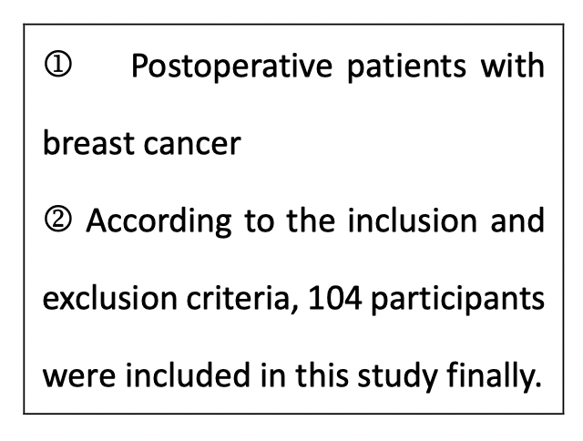
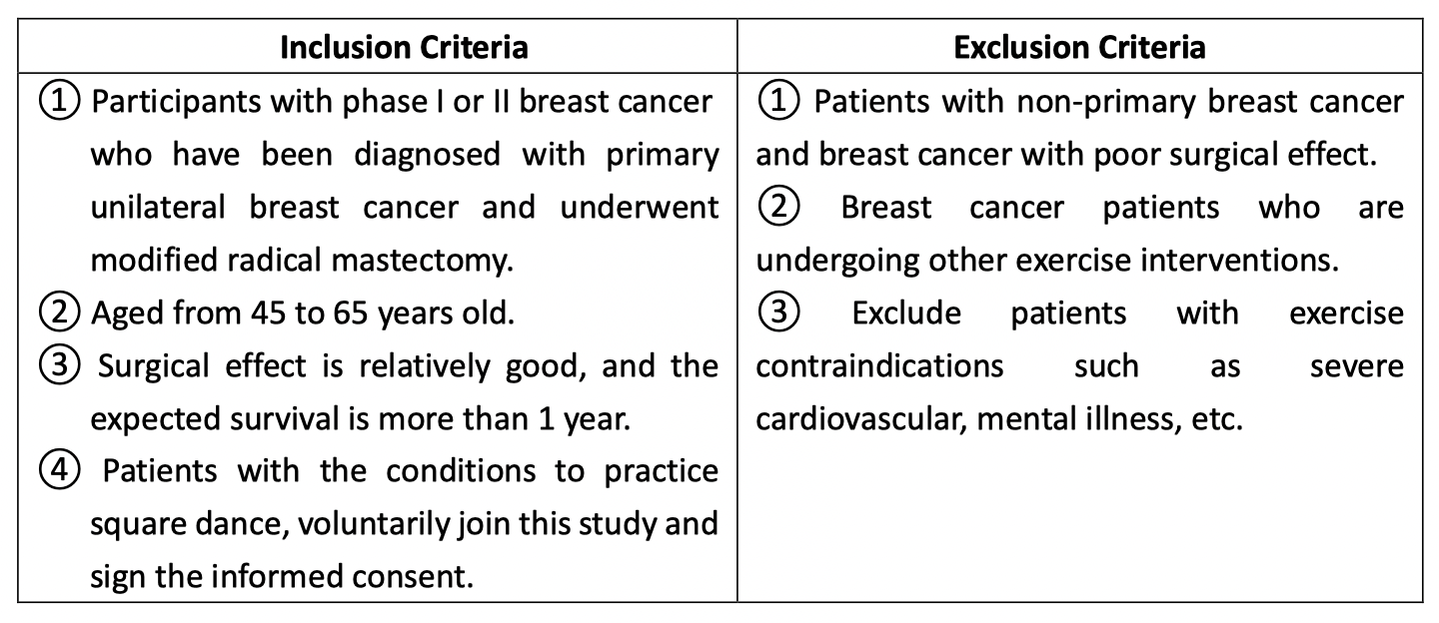
METHODS
Population and sample
Inclusion and exclusion criteria

Slide 5
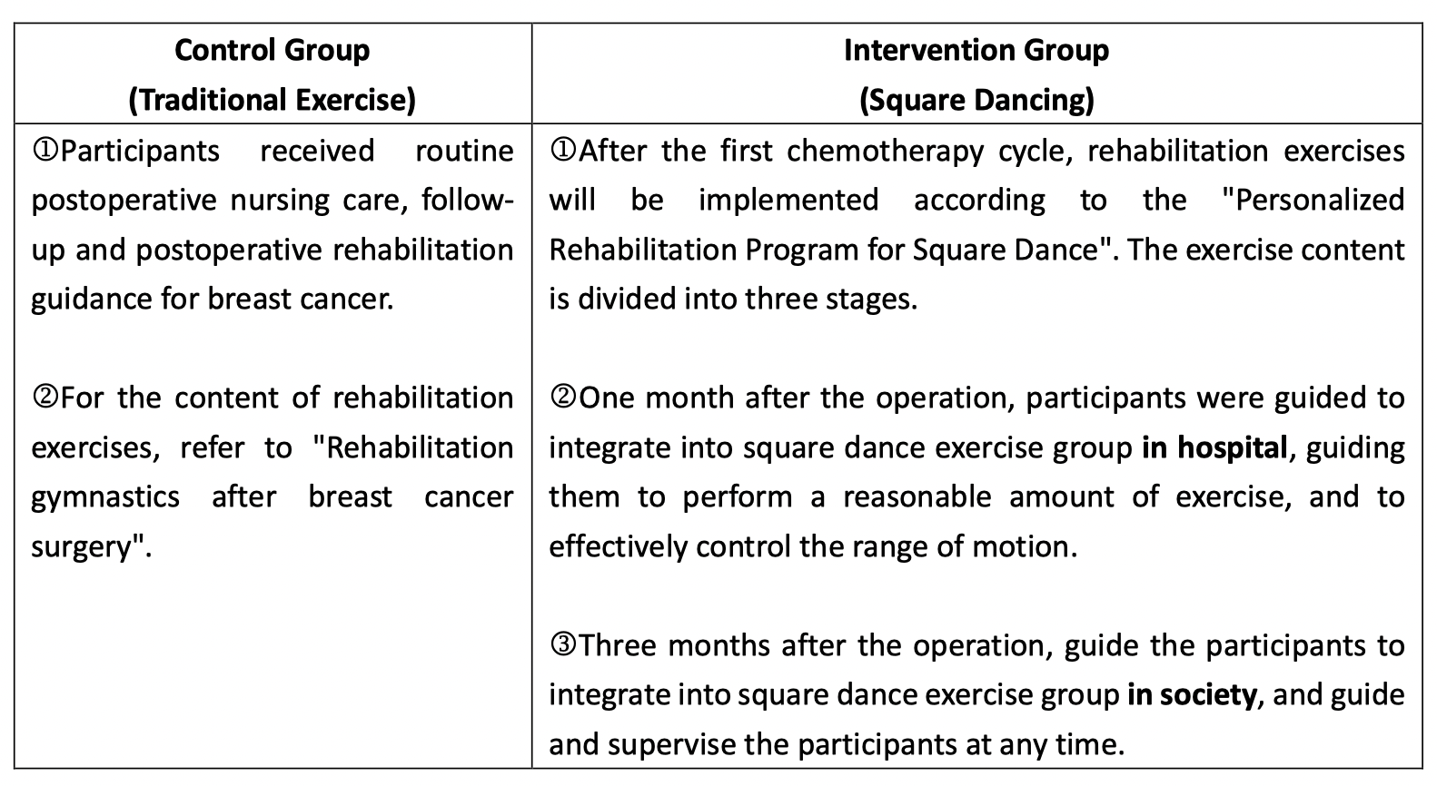
METHODS
Research implementation plan

Slide 6
MEASUREMENTS
The Constant–Murley Score (CMS)— The CMS is a multi-item functional scale assessing pain, ADL, ROM and strength of the affected shoulder and has been widely in the worldwide.
(2) Cancer Fatigue Scale (CFS)—CFS is a brief, valid, and feasible measure of fatigue for use with cancer patients.
(3) Self-Rating Anxiety Scale (SAS)—The SAS is a method of measuring levels of anxiety in patients who have anxiety-related symptoms.
(4) Self-Rating Depression Scale (SDS)—The SDS is a short self-rated scale that assesses the psychological and somatic symptoms of depression.
(5) The World Health Organization Quality of Life – BREF (WHOQOL-BREF) —It includes 4 domains
of quality of life (QOL): physical health, psychological health, social relationships, and environment.

Slide 7
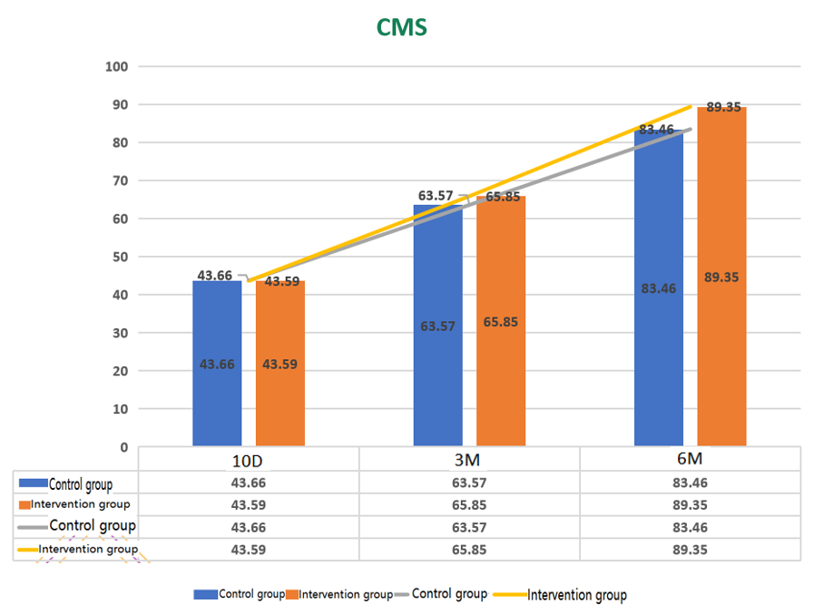
RESULTS
Comparison of CMS Between the Control Group and the Intervention Group
The results of the study showed that after 10 days post-surgery, the participants were able to perform simple physical activities.
It can be seen from the picture that the intervention group (square dancing) was significantly better than the control group in terms of pain, ADL (activities of daily living), ROM (range of motion), and strength of the affected shoulder.

Slide 8
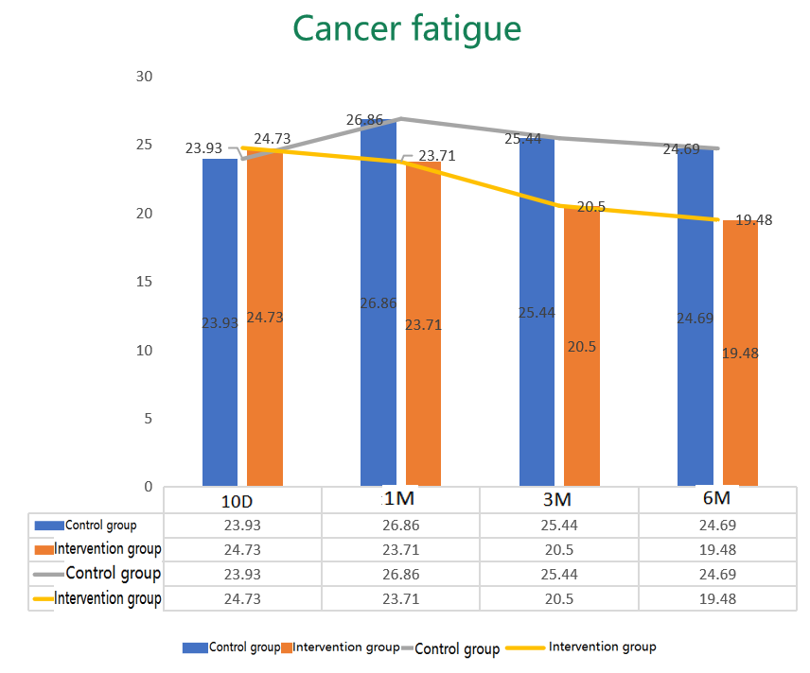
RESULTS
Comparison of Cancer Fatigue Between the Control Group and the Intervention Group
The picture shows that the fatigue of the patient increased slightly from 1 month to 3 months after the operation in both groups, and the possible explanation is the chemotherapy caused the patient’s physical discomfort to increase.
With the application of square dance to such patients, the fatigue level of the intervention group was significantly lower than that of the control group at 6 months, suggesting that square dance may
reduce cancer-related fatigue.

Slide 9
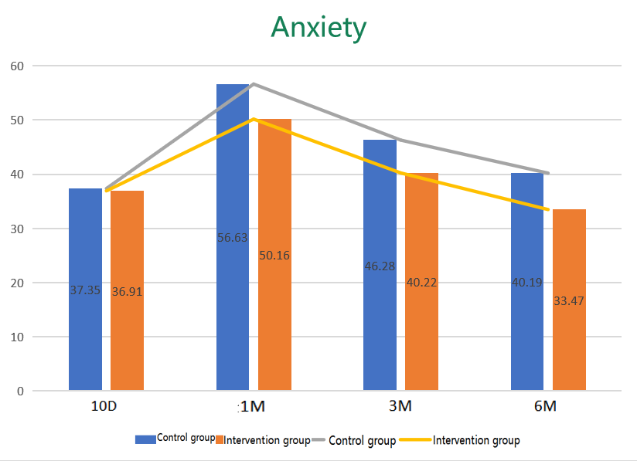
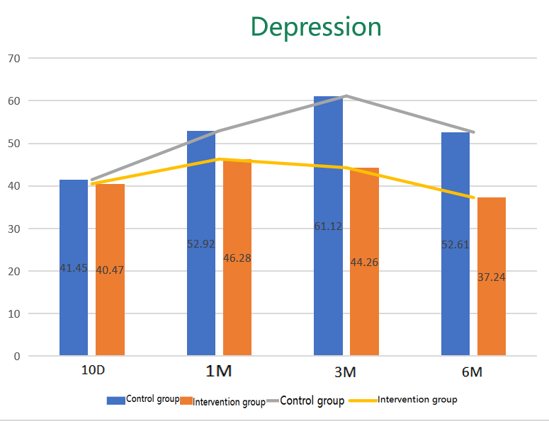
RESULTS
Comparison of Anxiety and Depression Between the Control Group and the Intervention Group
At 6 months, the anxiety and depression of the participants had almost disappeared, indicating that square dancing can relieve anxiety and depression.

Slide 10
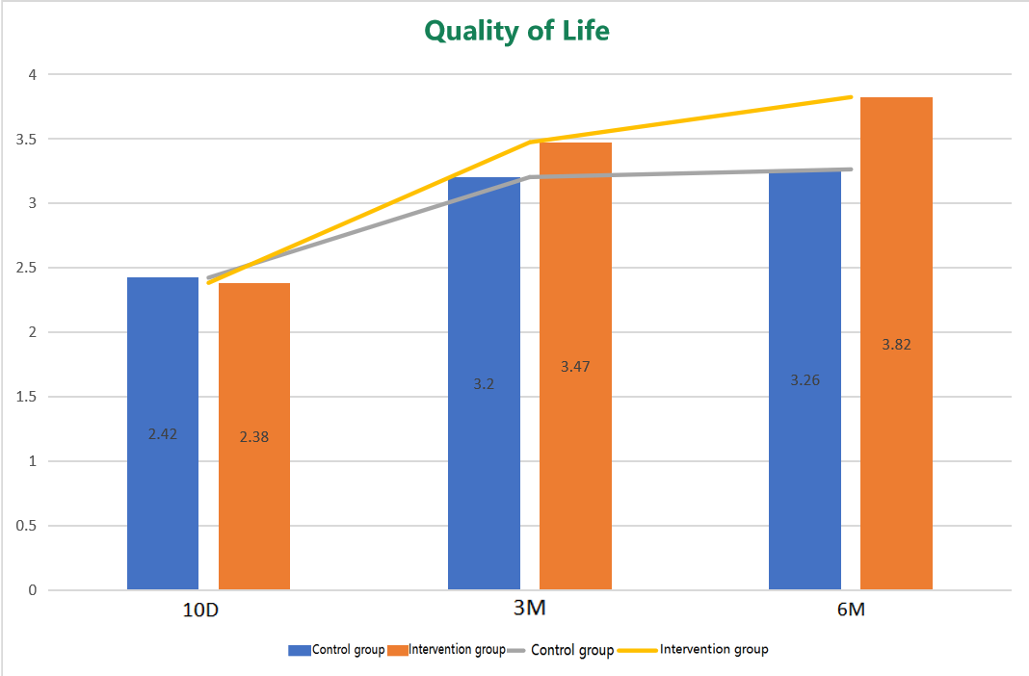
RESULTS
Comparison of the Quality of Life Between the Control Group and the Intervention Group at Different Stages
Quality of life scores were lower in both groups at 10 days postoperatively, but the difference was particularly significant after 3 months.
It shows that square dance intervention can improve the quality of life of breast cancer patients after surgery.

Slide 11
DISCUSSION & CONCLUSIONS
Square dance exercise has a good effect on the recovery of upper limb function in patients with breast cancer surgery, and the effect is better than traditional postoperative rehabilitation exercise.
As a group exercise, square dance can effectively improve the anxiety and depression of patients after breast cancer surgery. Moreover, the satisfaction of patients with postoperative rehabilitation exercises of square dance is high, and they have good exercise compliance.
Square dance can effectively reduce the fatigue of patients after breast cancer surgery and improve the quality of life of patients.

Slide 12
DISCUSSION & CONCLUSIONS
This is the first time that square dancing has been applied to the rehabilitation function exercise of postoperative patients with breast cancer
Square dance plays an important role in the postoperative rehabilitation of breast cancer patients. It can not only help patients get out of the negative emotions of cancer as soon as possible, but also enable them to better integrate into society and improve the quality of life of patients after surgery.

Slide 13
DISCUSSION & CONCLUSIONS
The sample of this study is only from a certain city in Anhui Province, which may not be able to generalize the results of this study to other cities or provinces in China.
The time of surgical treatment of the research subjects is inconsistent, and no previous studies have shown whether the operation time has an impact on the research results.
Participants have different levels of education, and there are subjective deviations in their understanding of the questionnaire questions.

Slide 14
REFERENCES
Bedillion, M. F., Ansell, E. B., & Thomas, G. A. (2019). Cancer treatment effects on cognition and depression: The moderating role of physical activity. The Breast, 44, 73-80.
Bray, F., Ferlay, J., Soerjomataram, I., Siegel, R. L., Torre, L. A., & Jemal, A. (2018). Global cancer statistics 2018: GLOBOCAN estimates of incidence and mortality worldwide for 36 cancers in 185 countries. CA: a cancer journal for clinicians, 68(6), 394-424.
Chekroud, S. R., Gueorguieva, R., Zheutlin, A. B., Paulus, M., Krumholz, H. M., Krystal, J. H., & Chekroud, A. M. (2018). Association between physical exercise and mental health in 1· 2 million individuals in the USA between 2011 and 2015: a cross-sectional study. The lancet psychiatry, 5(9), 739-746.
Compen, F. R., Bisseling, E. M., Schellekens, M. P. J., Donders, A. R. T., Carlson, L., Lee, M., & Speckens, A. E. M. (2018). Face-to-face and internet-based mindfulness-based cognitive therapy compared with treatment as usual in reducing psychological distress in patients with cancer: a multicenter randomized controlled trial.
Lei, Y. Y., Ho, S. C., Kwok, C., Cheng, A., Cheung, K. L., Lee, R., & Yeo, W. (2020). Longitudinal changes in sports activity from pre-diagnosis to first five years post-diagnosis: a prospective Chinese breast cancer cohort study. BMC cancer, 20, 1-14.
Mok, J., Brown, M. J., Akam, E. C., & Morris, M. A. (2022). The lasting effects of resistance and endurance exercise interventions on breast cancer patient mental wellbeing and physical fitness. Scientific Reports, 12(1), 3504.
Renninger, M., Hansen, B. H., Steene‐Johannessen, J., Kriemler, S., Froberg, K., Northstone, K., ... & International Children's Accelerometry Database (ICAD) Collaborators. (2020). Associations between accelerometry measured physical activity and sedentary time and the metabolic syndrome: A meta‐analysis of more than 6000 children and adolescents. Pediatric obesity, 15(1), e12578.
Ribeiro, I. L., Moreira, R. F. C., Ferrari, A. V., Alburquerque-Sendin, F., Camargo, P. R., & Salvini, T. F. (2019). Effectiveness of early rehabilitation on range of motion, muscle strength and arm function after breast cancer surgery: a systematic review of randomized controlled trials. Clinical rehabilitation, 33(12), 1876-1886.
Stamatakis, E., Gale, J., Bauman, A., Ekelund, U., Hamer, M., & Ding, D. (2019). Sitting time, physical activity, and risk of mortality in adults. Journal of the American College of Cardiology, 73(16), 2062-2072.
Sun, X. Y., Peng, Y. Y., Zhu, J. Y., Zhang C., Wang Y. B., Wang Y. L. (2020). Effect and mechanism of Taijiquan exercise on functional recovery of affected limbs after breast cancer surgery. The Chinese Journal of Physical Medicine and Rehabilitation, 42(12), 1088-1090.
Zhou, K., Ning, F., Wang, W., & Li, X. (2022). The mediator role of resilience between psychological predictors and health-related quality of life in breast cancer survivors: a cross-sectional study. BMC cancer, 22(1), 1-8.

Slide 15


