Slide 1


Understanding decision-making experience regarding hematopoietic stem cell transplantation in adult patients with blood cancer in Vietnam: Through the perspectives of relational autonomy
Nguyen Thi Quyen
MSc Nursing, Department of Nursing, National Cheng Kung University, Taiwan
Registered Nurse, Vinmec International Hospital, Vietnam

Slide 2
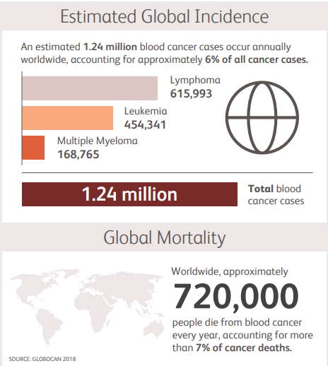
Blood cancer
Characterized by the overproduction of an abnormal type of blood cell.
Leukemia, Lymphoma, Multiple Myeloma, Myelodysplastic Syndromes (MDS), and Myeloproliferative Neoplasms (MPN)
(GLOBOCAN, 2018; Blood Cancer UK, 2023)

Slide 3
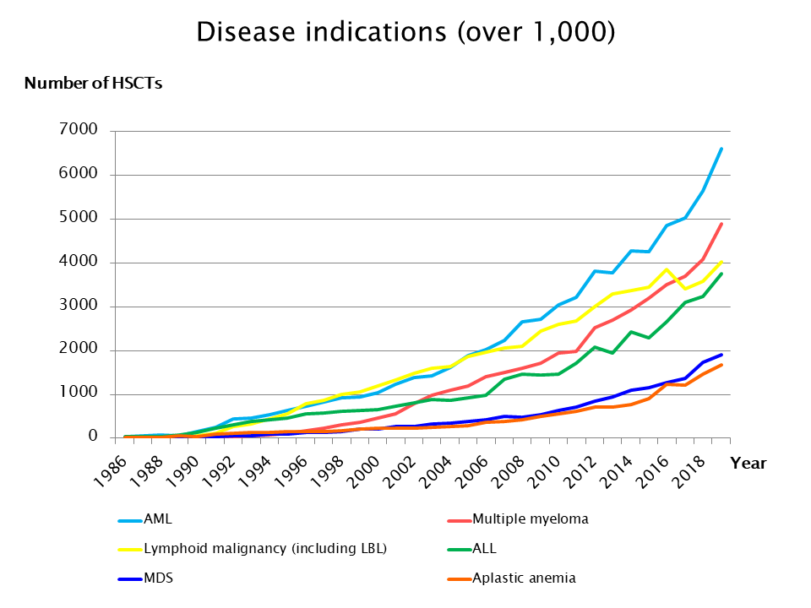
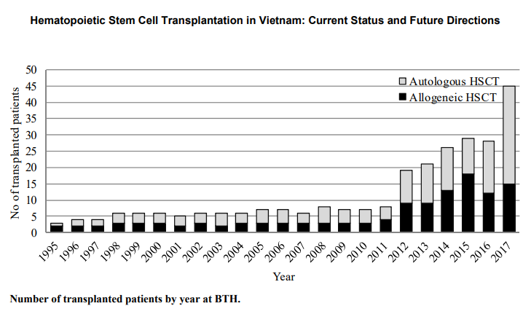
HSCT for blood cancer treatment
Asia
BTH in Vietnam
(APBMT, 2022; CIBMTR, 2020; Huynh et al., 2018, CESTI, 2013)

Slide 4
Factors influencing patient decision-making regarding HSCT
1
Age
6
Stem cell donor
2
Lacking knowledge of HSCT
7
Trust in health care providers
3
Faith and beliefs
8
Family support
4
Balancing benefits and risks
9
Peer’s experience
5
Treatment cost
(Deeg et al., 2021; Weisdorf, 2021; Tariman et al., 2012; Randall et al., 2016; Pisu et al., 2014; Stiff et al., 2006; Khemani et al., 2018; Cho et al., 2020; Spierings et al., 2020; Cooper et al., 2017; Gupta, 2012; Besien et al., 2001; Hutson et al., 2015; Ragsdale et al., 2014; Forsyth et al., 2011; Solanki et al., 2021; Jordens et al., 2013; Aguiar et al.,2021; Inamoto et al., 2017; Walker, 2020; Sun et al., 2010 ; NIHBT, 2022; Im et al., 2020)

Slide 5
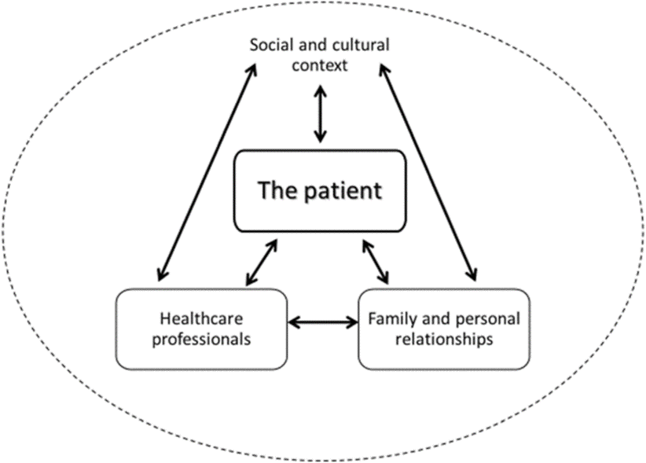
The concept of relational autonomy
RA represents the competence to make decisions as a process of considering various relational factors
People's interests, goals, beliefs and decision-making capacities as continually developed and recreated in dialogic processes with others: construct self-identities, providing support, promoting choices.
Allows to practice decision-making as a multi-dimensional review: not only the right or a single moment to make decision, but also a process of considering aspects to make optimal decisions.
A social location determines what types of opportunities are available to support person’s development of autonomy
Schematic diagram of a relational approach to patient autonomy in end-of-life decision-making (Gómez et al., 2020)
Notes:
Lesson descriptions should be brief.

Slide 6
Research purposes
To understand blood cancer patient decision-making experience regarding hematopoietic stem cell transplantation through the concept of relational autonomy
Specific aims:
To understand the patient decision-making experiences in HSCT participation.
To explore factors influencing patient decision-making regarding HSCT and understand how these factors influence their decision-making.
To understand how patients demonstrate relational autonomy in HSCT decision.

Slide 7
Methods
Research design | A qualitative research design with interview approach
Sampling method | Convenient sampling and snowball sampling
Sample size | Approximately 20-30 participants
Inclusion criteria | Adult patients who aged 18 and above, Able to speak Vietnamese, Being diagnosed with blood cancer, Had been offered the treatment option for HSCT (including acceptors and refusers) within two-year prior to approach.
Exclusion criteria | Patients with cognitive impairment or communication disorder who cannot describe their experience
Data collection | August 2022 => February 2023 Online Interview Hanoi & Ho Chi Minh City
Data analysis | Content analysis

Slide 8
Interview Guide
Could you please recall when and how you have been informed of a treatment option for HSCT?
Could you please share your experience about the decision-making to receive HSCT?
Follow up questions:
Before you make a decision, how did your past treatment experience influence your decision?
Before you make a decision, did you discuss it with anyone? Why did you discuss with her/him? How did these discussions influence your decision?
Could you please share what were your considerations in the decision-making process?
What were the motivations when you decided to receive HSCT? What was the most important?
What were the difficulties or barriers when you consider receiving HSCT? What was the most important? How did you address your difficulties?
What were your other concerns when you considered HSCT?
How long did it take you to make a decision? What were your final decision?
Could you please share what was your feeling when you made that decision?
Could you please share what is your current feeling related to the decision you made?
Regarding your decision-making process of HSCT, do you have anything else that want to share with me?

Slide 9
Qualitative content analysis
Triangulation, peers checking
Meaningful
units
Condensation
Codes
Categories
Sub-themes
Themes
2001
274
65
23
10
4

Slide 10
Themes – subthemes
Themes | Subthemes
1. Illness encounter portraying a treatment hint | 1.1. Identity transitioning when entering the "kingdom of sick"
 | 1.2. Perceiving a treatment option from environmental orientation
2. A consideration process from self-reflection to external influences | 2.1. Essential preparation for a significant decision
 | 2.2. Reviewing HSCT through personal perspectives and others experiences
 | 2.3. Internalized and externalized motivations driving decision-making
3. Achieving a dynamic balance in decision-making process | 3.1. Facilitations relational autonomy demonstration
 | 3.2. Restrictions to practice relational autonomy
 | 3.3. Dynamic balance of power in achieving the final decision
4. Eventual decision and its long-term repercussion on decision-makers | 4.1. Attitude toward decision-making outcomes
 | 4.2. Raising the voice for future decision-making support

Slide 11
Theme 1:
Illness encounter portraying a treatment hint
“I was at a young age and suddenly got sick like that…. When I was sick, I was generally quite shocked because I was at a beautiful age, I was only 24 years old. At that time, I was also very emotional. Everyone keep saying: "Oh my god, that's so poor, so bad, so young” suddenly I fell ill like that" (NIBTH01).
“When facing illness, I always look at it directly, see what it is and I always have the psychological awareness that I have been sick, I have to treat it. That's me, everything is predestined to come to me, so I should accept it and find a way to overcome it. When it happened to me, it was my karma that I would have to accept” (NIBTH04).
“I only have the biggest belief that I can recover from my illness, I can return to a normal life, I can go to work, I can be like them, that's one of the things that urges me to accept the challenge” (VM04) HSCT is my hope
Notes:
How presentation will benefit audience: Adult learners are more interested in a subject if they know how or why it is important to them.
Presenter’s level of expertise in the subject: Briefly state your credentials in this area, or explain why participants should listen to you.

Slide 12
Theme 2:
A consideration process from self-reflection to external influences
“My family has only me and my son, he is very small. I had to think about it all, what if I wasn't lucky.... Well, I guess his father wouldn't have abandoned him. Grandpa then my brothers and my sister I'm sure they won't abandon him. I have a house there, everything is there. Just keep raising him, I'm sure no one will abandon him” (NIHBT08).
“For this disease, the HSCT has many problems, the first is the very big risk. It is an opportunity but it is also risk and challenge. I have a comparison. Of course, it will be fifty-fifty. One is gain, two is a loss” (NIBTH04).
“During the treatment process, I also witnessed many patients who were not strong enough to fight, they gave up, there were times when the hospital ran out of medicine, and I also saw many people leaving. At that time, of course, I was also worried about myself” (BTH05).

Slide 13
Theme 3: Achieving a dynamic balance in decision-making
Patient
Respect the decision
Respect the decision
2-way relationship
Share decision-making
Healthcare
professionals
Respect the decision
Family
Trust
Notes:
How presentation will benefit audience: Adult learners are more interested in a subject if they know how or why it is important to them.
Presenter’s level of expertise in the subject: Briefly state your credentials in this area, or explain why participants should listen to you.

Slide 14
Theme 3:
Achieving a dynamic balance in decision-making
“The communication between the patient and the doctor should also have a two-way relationship, enhancing the experience and being more effective… In general, I also keep a good relationship with the doctor and especially I have my own ideas.” (NIBTH02)
“Actually, I got this disease when I was only seventeen years old. I'm still very young, I can't decide for myself. It's not that I don't decide, but because of course I'm young, my parents have to make the decision. Because my father has money, my father has research about situation, my father is interested in learning a lot of information, and also regarding financial issue, right? ...

Slide 15
Theme 4:
Eventual decision and its long-term repercussion on decision-makers
“Ever since I made that decision, both me and my family have tried a lot in terms of time, effort, money, and many different factors. Well, until now he and everyone are satisfied and also see that it was a right decision” (NIBTH02).
“That's me, ... Just like myself, I hope many people are as lucky as me. Either this or either health insurance is likely to pay for most of the costs of transplants for patients to have access to. If not, it is possible that hospitals could implement programs. In general, there are charitable sources, there are budget sources, which can mobilize budget sources to support them in part or to give them access to it…Well, I hope that in the future, if you can make a call as a person taking care of your patients, call for fund. To be able to help them somewhat.” (VM04).

Slide 16
Discussion
Getting illness provides a context that encourages individuals to participate in decisions, ask questions and get references, voice their feelings and concerns, and take responsibility for their decisions (Dodds, 2000; Spierings et al., 2020; Tariman et al., 2014).
Different situations of HSCT approaches made different perceptions and attitudes about HSCT => Social context had influences on patient’s point of view regarding treatment option (Walter et al., 2014; Dove at al., 2017).
Receiving support from relationships (family, HCPs, personal rapports) foster a person’s capacity to be autonomous, help them get more strength and closer to the final decision (Solanki et al.,2021, Shih et al., 2018; Bell et al., 2015)
Undue interference of FMs and time constraint affect ability to make decisions autonomously and makes patient care more challenging (Fuller et al., 2022; Schneider, 1998; Maule & Edland, 1997; Musken et al., 2019).
The final say in the decision-making is not only the moment that patients look into themselves but also looking for the accompany and interactions with their family, HCPs (Asiedu et al., 2018; Caocci et al., 2011; Mekelenkamp et al., 2021)
Satisfaction with the decision they already gave, regardless of agreeing HSCT or declining HSCT (Khemani et al., 2018; Gallo et al., 2019; Cho et al., 2020)

Slide 17
Discussion – New findings
Underline the shock and vulnerable emotions when coping with the illness, and patient's behaviors to adapt to the disease, including accepting, self-change, self-taking care, positively thinking, and finding the accompanies.
Not only experiences of other patients, patients also considered the positive and negative performance of HCPs and the experience of FMs.
The need of family support in physical and psychological and the need for time to deliver the quality decision.
The scarcity of medication and dependence on foreign companies are barriers that keep patients waiting despite the HSCT desire.
The relationship with HCPs regarding treatment decision-making should be two-way interaction to enhance the effectiveness of the discussion and balance the power in decision-making between patients and HCPs
Expectations for the healthcare system and HCPs in enhancing decision-making support, including providing more financial support, paying attention to nursing care to support patient’s psychological health in advanced HSCT, or improving the facility quality.

Slide 18
Conclusion & Recommendations
Decision-making process on HSCT are influenced by their understanding, life values, the experiences of peers, the performance and relationship with HCPs, and the support and empathy of family.
HSCT decision-making is a dynamic balance with the involvement of different parties and multidimensional influential power, which constraining or facilitating patient's autonomy, develop or shape the autonomous decision-making skill of patients.
By understanding what factors influencing patient’s decision-making, HCPs could provide more effective consultation prior to HSCT, open more access to HSCT, and develop the informed consent to be optimal effectiveness.
HCPs should pay attention to the factors facilitating and constraining patient relational autonomy and expectations of patients to facilitating and supporting patient decision-making.

Slide 19

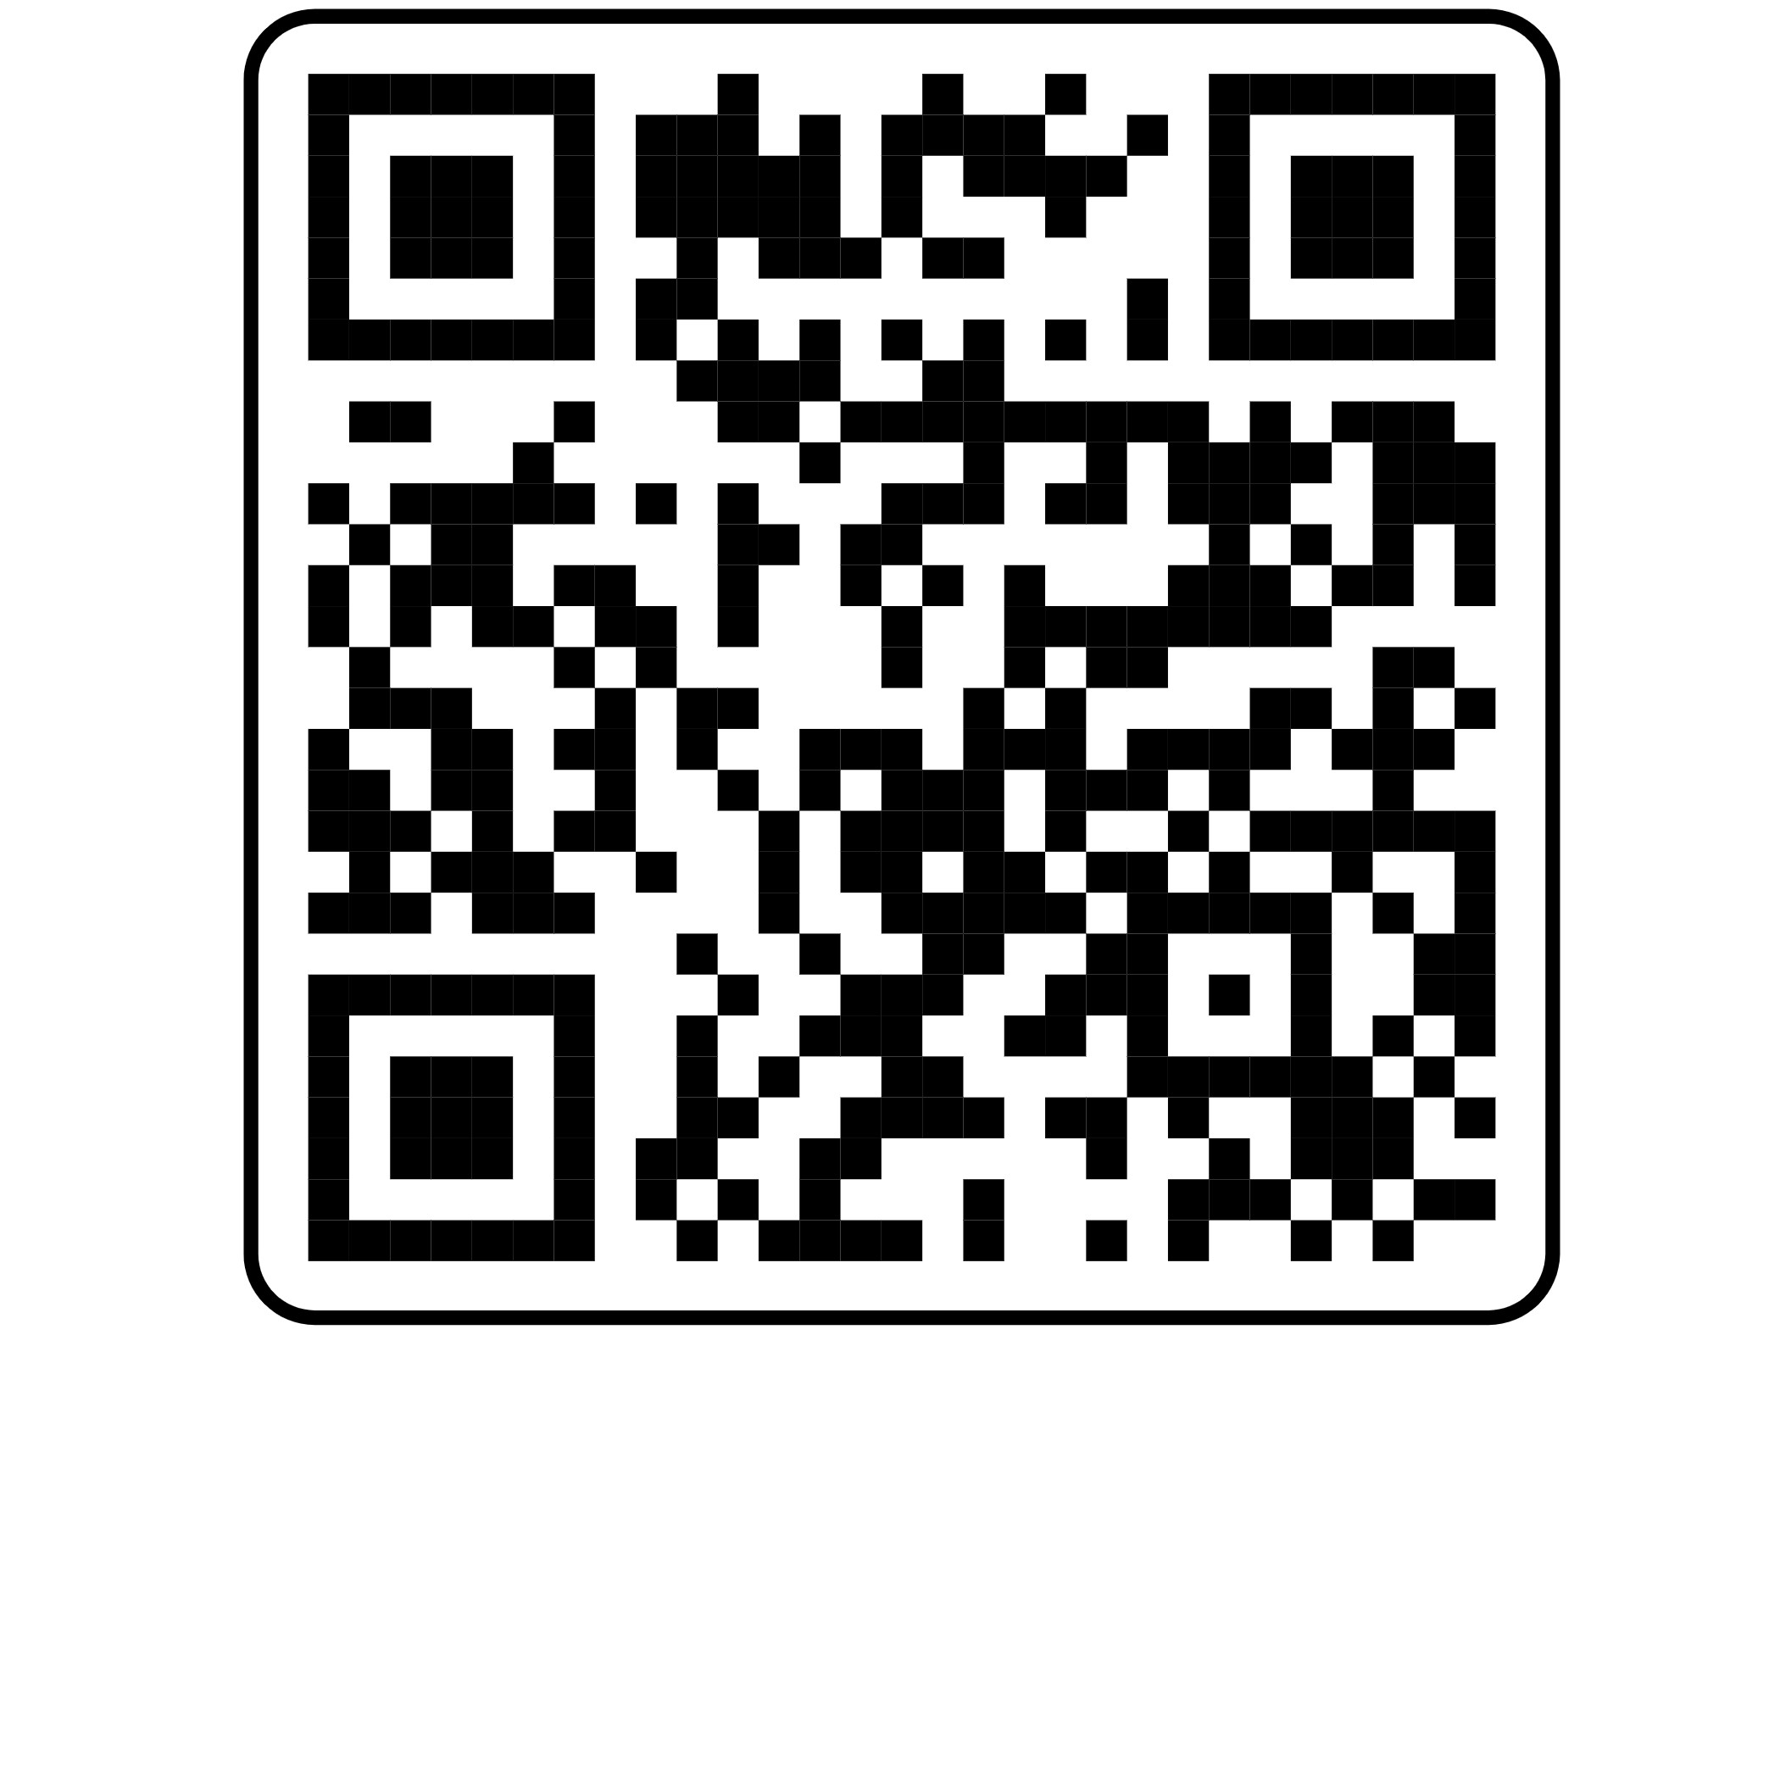
Thank you!
Scan this QR code for references:

