Slide 1


The Growth and Adaptation of a National Cancer Nurse Practitioner Network
Gillian Blanchard, Sue Bartlett, Rebecca Booth, Michael Cooney, Michael Fitzgerald,
Justin Hargreaves, Gillian Kruss, Kristin Linke, Vicki McLeod, Marissa Stevens
CNSA Cancer Nurse Practitioner Specialist Practice Network Committee

Slide 2

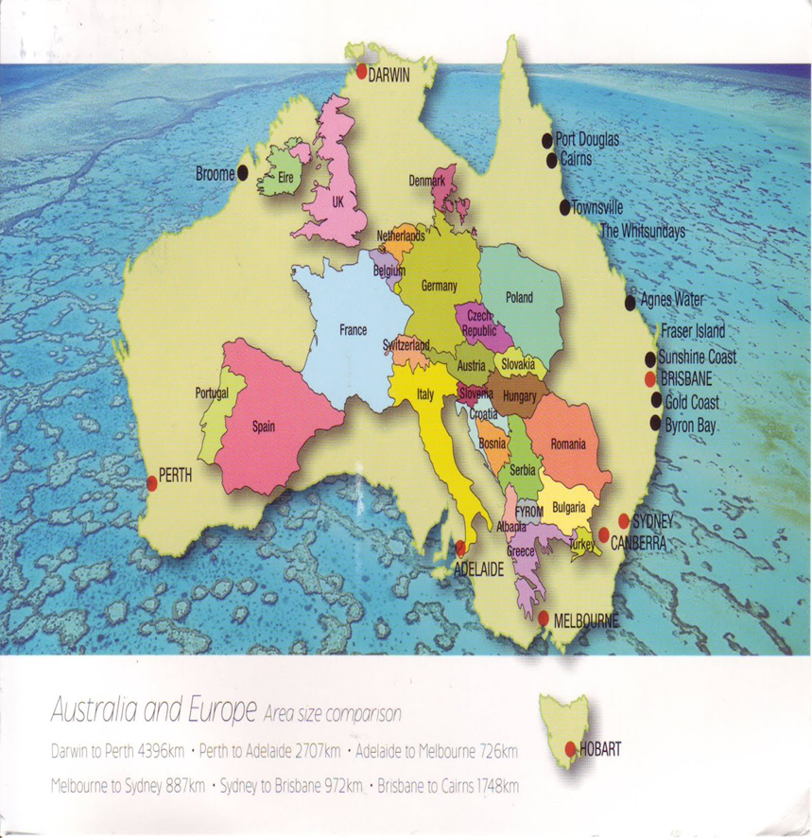
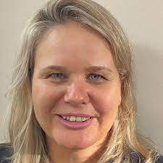
Notes:
As you can see Australia is geographically vast covering over 7,692,024 km2.
In Australia approximately 150000 Australians are diagnosed with cancer every year and and nearly 1/3 of these will die of the disease.

Slide 3
NPs in Australia
Part of Australian Health care Setting for 23 years
In Cancer Care for approximately 15 years
Cancer Nurses remain only 2% of total nursing population
Nurse Practitioners make up approx. 0.01% of this group
Cancer NP Model well established in USA¹
NPs shown to improve numbers completing both chemotherapy and radiation treatment²
Patients are complex and require a specialist nursing workforce to manage and improve outcomes³
Notes:
Nurse Practitioners have been part of the Nursing fabric since the 1960s when they began in the United States. In the 1980s Nurse Practitioners began in the United Kingdom.
In Australia the role is relatively new with NPs only being part of the health care setting for the last 23 years with the first endorsements occurring in 2000.
In Australia Cancer Nurses only make up about 2% of the total nursing population with cancer Nurse practitioners being only 0.01% of this number.
The NP model fits well in a cancer care setting not only can enhance patient care and satisfaction but create consistency and has been well established the USA.
This model of care has also been shown to improve numbers of patients completing chemo and radiation due to the close toxicity monitoring they do. This also has to some extent decreased hospitalisation rates.
The complexity and acuity of patient needs means that a specialised nursing workforce is needed to help manage these patients. From this a national network of cancer nurse practitioners (CNP) was created to address the education needs and provide networking opportunities and peer support.

Slide 4
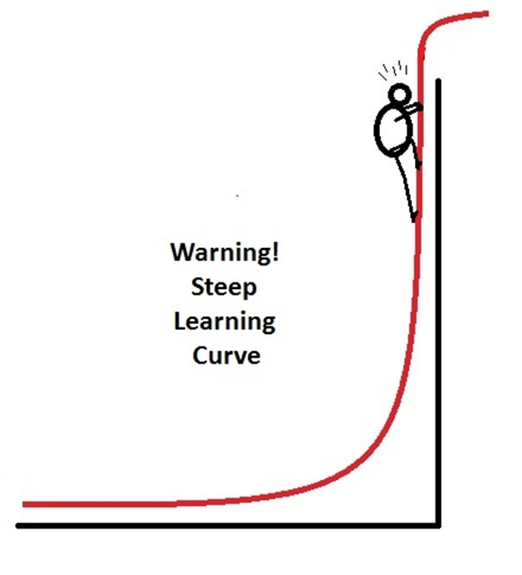

“A tortuous journey towards a partially unknown destination”⁴
Notes:
So why is this network so important? Well the transition from a senior nursing clinician to a NP is very different. It feels not only like having been the big fish in the big pond to now the small fish in the big pond again, similar to when first starting nursing but also it makes you well aware that your undergraduate or even post-graduate training does not equip you with the skills to work to the full level of your scope of practice.
The learning curve is very steep. You are now expected to have the clinical examination and radiology skills of your medical counterparts but also know everything there is about what is current in cancer treatments and care. Which is actually very unrealistic.
The development of these roles has been described as a tortuous journey towards a partially unknown destination.

Slide 5
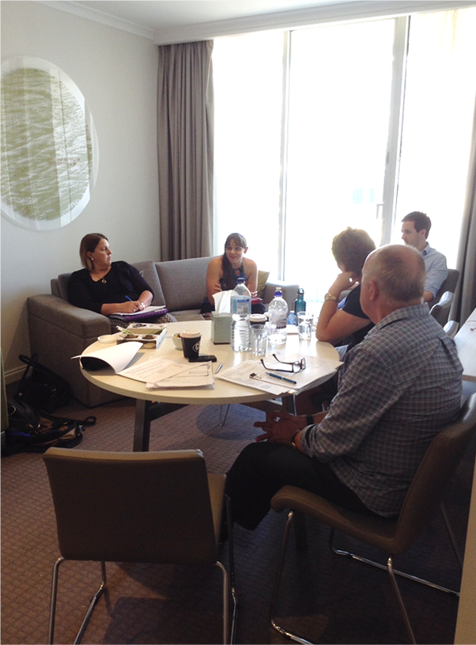
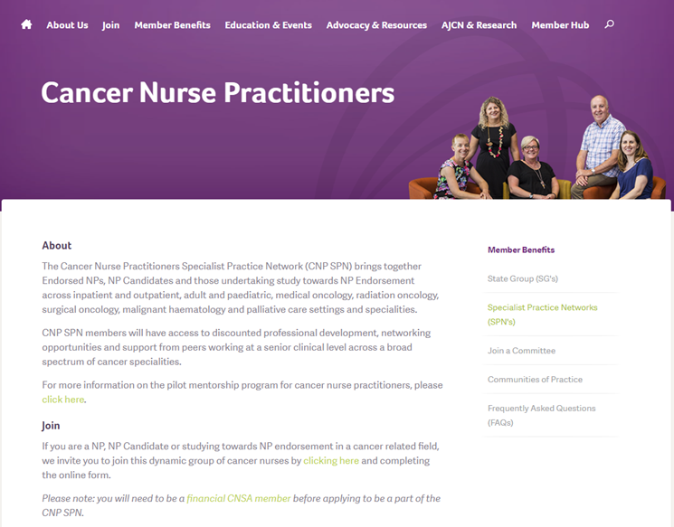
The Vision
Notes:
In 2013 a group of CNPs known then as the National Cancer Nurse Practitioner Network got together in a hotel room and discussed how we could make relevant support and education to all cancer nurse practitioner students, candidates and endorsed NPs across the country. At this time there were believed to be only 18 spread across all states of the country but growing with increasing funding.
After some negotiation the previously named aligned professionally with the Cancer Nurses Society of Australia. CNSA offered membership record, database emails to members on behalf of chair, teleconference facilities, modest secretarial support (minutes typed!), manage funds finances included with financial audit, support nominations and elections, support chair to attend CNSA exec meeting annually.
This professional alignment brought value and authority to the group, ensured sustainability and professional representation.

Slide 6
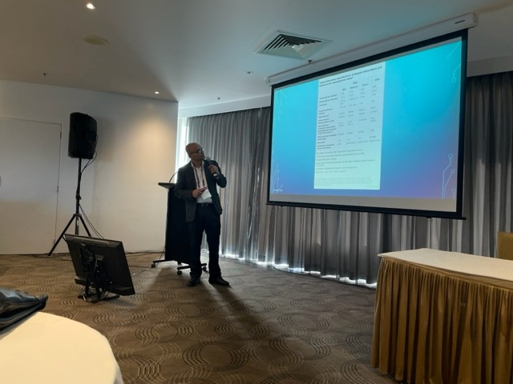
Education Provided
3 days of face to face educational opportunities each year
Education is tailored to the level of student NP through to NP with extensive experience
1 day is always attached to a major nursing conference
Examples include:
  Haematology and Infectious diseases
  Physical Assessment
  Radiological Assessment
  Pharmacology
  Pathology and prescribing
Notes:
The CNSA CNP group provides the opportunity for 3 days of face to face education each year. We ensure 1 of these days is attached to a major nursing conference (usually CNSA). This reduces the amount of annual travel but also the travel support we provide to members help them to also get to congress. The other 2 days are held the second half of the year
These are examples of some of the education sessions we have had and we are planned for genomics and a wet lab at the end of this year

Slide 7





How is this Supported
Sponsorship from Pharma
Obtained through a formal Prospectus with varying levels of sponsorship
Notes:
Our education days often attract p to 60 participants from a current membership of around 103. These are only made possible by the sponsorship of farmer as each workshop can cost in the order of $20K plus.
Sponsorship is obtained using a formal prospectus with varying levels of sponsorship from platinum to event sponsor only. These are a few of our sponsors for this year.

Slide 8



What does this Sponsorship Provide?
Hiring of an event coordinator
Venue and catering
Honorariums for invited speakers
Travel Grants
Other projects eg. mentoring
Notes:
The travel grants we provide each member is $500 each year for support of airfare or accommodation costs. The actual event is free to attend for members.
Sponsorship also has helped us roll out a NP mentoring project. This led to the development of a validated NP self-assessment tool and a program aimed to help novice NPs better transition to endorsed NP positions. This involves a monthly met up between mentor and mentee for 12 months and this will then be evaluated.

Slide 9
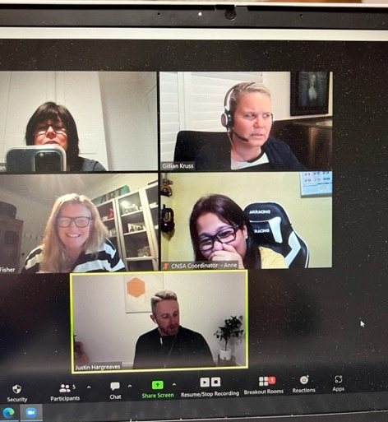
Adapting to Change
Notes:
Like all countries COVID impacted on our ability to provide face to face education to our members.
Networking is such a huge part of being a member of this group so it was important that education felt not only relevant but also gave the opportunity do some networking. Like everyone we became pretty adapt at online education events and meetings and these took the place of our face to face meetings. These were well received by members who valued not only the content but also opportunity to talk about clinical issues.

Slide 10
Policy and Advocacy
Medicare Benefits Schedule Review
Prescribing endorsement for registered nurses
Nurse Practitioner Accreditation Standards
Nurse Practitioner 10 year Plan Consultation Paper
The Australian Cancer Plan (ACP) 2023-33
Notes:
Another important part of the group is its role in policy and advocacy and providing a voice on important topics that impact Cancer NPs now and in the future.

Slide 11
Conclusion
Development and continued sustainability of the CNP SPN is vital
The CNP SPN helps develop and advance clinical practice for CNPs across Australia
The CNP SPN provides a voice in matters of policy and advocacy
This model is easily adaptable and could be replicated in other countries

Slide 12
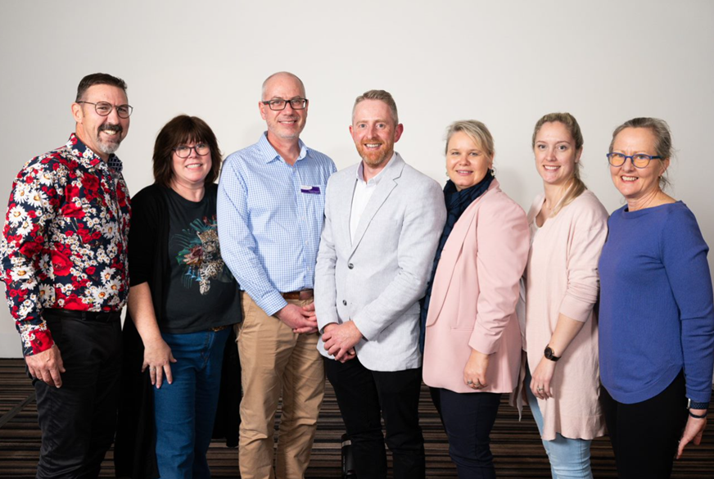
Thank You

Slide 13
References
Bishop, C. (2018). An Oncology NP-MD Partnership: Challenges and Rewards. Journal of the Advanced Practitioner in Oncology. https://doi.org/10.6004/jadpro.2018.9.4.6
Mason, H., DeRubeis, M. B., Foster, J. C., Taylor, J. M., & Worden, F. P. (2013). Outcomes evaluation of a weekly nurse practitioner-managed symptom management clinic for patients with head and neck cancer treated with chemoradiotherapy. Oncology nursing forum, 40(6), 581–586. https://doi.org/10.1188/13.ONF.40-06AP
Fraze, T., Briggs, A. D. M., Whitcomb, E. K., Peck, K. A., & Meara, E. (2020). Role of nurse practitioners in caring for patients with complex health needs. Medical Care, 58(10), 853–860. https://doi.org/10.1097/mlr.0000000000001364
Andregård, A., & Jangland, E. (2014). The tortuous journey of introducing the Nurse Practitioner as a new member of the healthcare team: a meta-synthesis. Scandinavian Journal of Caring Sciences, 29(1), 3–14. https://doi.org/10.1111/scs.1212

