Slide 1


Multiple symptom distress among children and adolescents with cancer and its correlations with physical activity：A latent profile analysis
Yanyan Liu, Lecturer, PhD,RN
School of Nursing, Shanghai JiaoTong University, Shanghai China
Email：Liuyy0621@126.com
Phone Number:(+86)15618993531

Slide 2

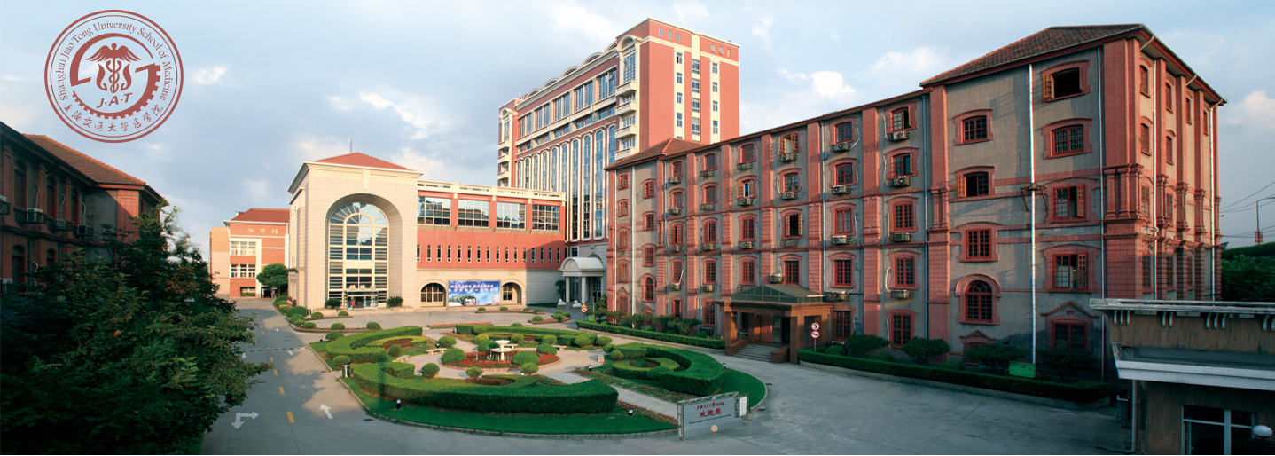

Introduction of Our University
- One of the first ten universities jointly supported by the Ministry of Health and the Ministry of Education of China.
- The first echelon of the nation's medical schools.
- Rich historic background of over one hundred years
- A research-oriented medical school with all-round development in medical education, clinical services, and scientific research, as well as other social services

Slide 3
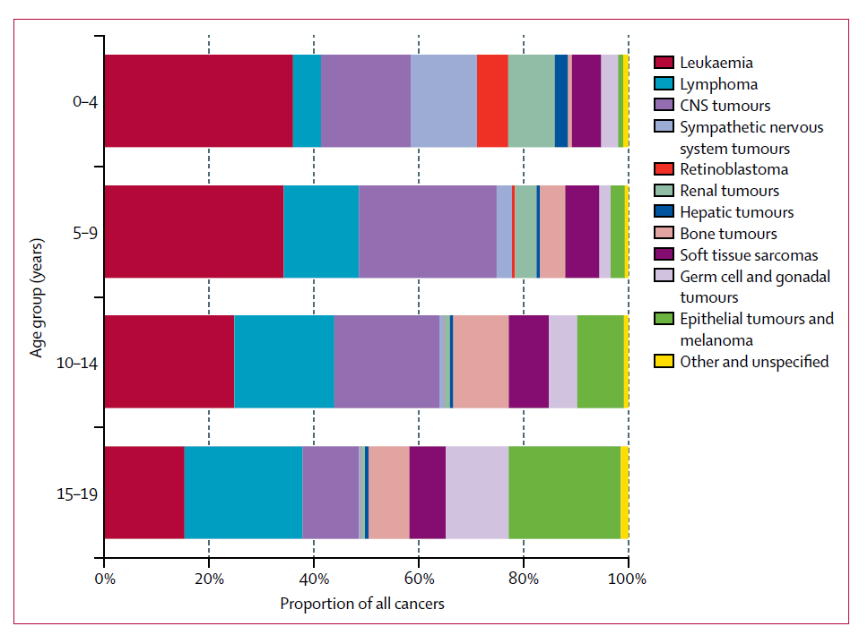
Introduction
Worldwide
- More than 380,000 children were diagnosed with cancer annually
0~14 year-old: 140.6 per million
15~19 year-old: 155.8 per million
China
The 5-year prevalence of cancer among children and adolescents in 2020 was 120,028
0~14 year-old
2009 107.8 per million
2012 113.5 per million
Figure 1 Proportional distribution of cancer type by age group, 2001–10, all regions combined Tumours classified by International Classification of Childhood Cancer

Slide 4
Introduction
- Cancer itself and the treatment of cancer have great impact on the children’s health status and lead to limited physical activities. Common symptom distress include fatigue, nausea, vomiting, emotional distress, etc.
-While a consistent focus has been placed on single symptom prevalence and management, more recent studies note that cancer symptoms rarely appear alone but more often co-occur as symptom clusters, which are two or more concurrent symptoms that are associated and have a common cancer cause.
-Studies on symptom clusters have normally used a symptom-centered approach to demonstrate the relationship between symptoms. such as pain-insomnia-fatigue etc. Latent profile analysis (LPA), one example of a person-centered approach. which classifies individuals from a heterogeneous population into homogeneous subgroups, making it possible to find the most severe patient groups and provide tailored supportive care to these groups.

Slide 5
Objectives
The aim of this study was to
identify groups of patients who experience similar levels of symptoms by using latent profile analysis (LPA)
explore the effect of profiles on physical activity among children and adolescents with cancer

Slide 6
Methods
Samples
Children with cancer aged 10-18 were eligible and recruited in two tertiary hospitals Inclusion criteria: diagnosed with cancer and were in treatment; (3) able to understand and speak Chinese; and (4) willing to participate in this study. exclusion criteria were: (1) psychiatric conditions or cognitive or other impairments (e.g., visual) and (2) a life expectancy of fewer than 6 weeks
Measures
Parent-reported: Demographic and disease-related questionaires
Child Self-reported：Memorial Symptom Assessment Scale (MSAS,10-18).
Children’ s Leisure Time Activities Study Survey (CLASS)

Slide 7
Methods
Statistical Method
LPA was used to identify the groups of patients who reported similar levels of symptom distress. The symptoms, of which the occurrence rates were higher than 40%, were included in the analysis. Chi-square and Mann-Whitney U test was used to test the relationship of the latent profile with physical activity.
Determining the optimal number of latent patient profile
Model fit indices (AIC,BIC,SABIC)
Model comparing test(LMR LR, ALMR LR, BLRT）
Examining the latent profiles classification
Defining/labeling the latent patient profile
Average posterior probabilities
The entropy statistic
Analyzing difference in physical activity level among patient profiles
Chi-square or Mann-Whitney U test
Mplus 7.1 and SPSS 25.0 were used to analyze the data.

Slide 8
Results
- A total of 165 valid samples were investigated. More than half of them were boys(N=108, 65.5%) and diagnosed with leukemia(N=63, 38.2%),brain tumor(N=43, 26.1%) and lymphoma(N=16, 9.7%)
Table 1. Sample characteristics(N=272)
Characteristics | Samples N | Samples % | Characteristics | Samples N | Samples %
Child gender |  |  | Type of cancer
Male | 108 | 65.5 | Acute Leukemia | 50 | 30.3
Female | 57 | 34.5 | Other Leukemia | 13 | 7.9
Child age(years) |  |  | Brain tumors | 43 | 26.1
10-14 | 136 | 82.4 | Lymphoma | 16 | 9.7
15-18 | 29 | 17.6 | Others | 43 | 26.1
Guardian relationship to child |  |  | anemia
Mother | 47 | 28.5 | No | 112 | 67.9
Father | 118 | 71.5 | Yes | 53 | 32.1

Slide 9
Results
The most distressful symptoms of children with cancer were hair loss with median 2.00(1.00,3.00), lack of energy 1.00(1.00,2.00), lack of appetite 2.00(2.00,3.00), changed taste1.00(1.00,2.00), nausea1.00(1.00,2.00), etc.
The children's physical activity level was higher in light physical activity (LPA), with an Median 2530.00 (1577.50, 3721.00) minutes/week and MVPA with 70.00 (10.00, 197.50) minutes/week.
Table2 The symptom distress of children with cancer（n=165, Incidence rate>40%）
Table3 The Physical activity levels of children with cancer
Symptom | N | Incidence Rate（%） | Distress P50（P25, P75）
Lack of energy | 143 | 86.7 | 1.00(1.00,2.00)
Nausea | 127 | 77.0 | 1.00(1.00,2.00)
Lack of appetite | 116 | 70.3 | 2.00(2.00,3.00)
sweat | 108 | 65.5 | 1.00(1.00,2.00)
Pain | 107 | 64.8 | 1.00(1.00,2.00)
Sleepy | 90 | 54.5 | 1.00(1.00,2.00)
Difficult in concentrating | 90 | 54.5 | 1.00(1.00,1.00)
Hair loss | 85 | 51.5 | 2.00(1.00,3.00)
Cough | 83 | 50.3 | 1.00(1.00,2.00)
Vomiting | 81 | 49.1 | 1.00(1.00,2.00)
Dry mouth | 80 | 48.5 | 1.00(1.00,2.00)
Weight loss | 80 | 48.5 | 1.00(1.00,2.00)
Scores of physical activity | P50（P25, P75） minutes/week | Score range minutes/week
PA（physical activity ） | 2625.00 (1690.00, 3870.00) | 330.00~10570.00
LPA（light physical activity ） | 2530.00 (1577.50, 3721.00) | 330.00~10570.00
MVPA（moderate-to-vigorous physical activity） | 70.00 (10.00, 197.50) | 0~1820.00

Slide 10
Results
-Two profiles were identified (Entropy=0.828)
Table 4 Comparisons of different LPA models of symptoms distress
Model | AIC | BIC | ABIC | LMR LR test P-value | ALMR LR test P-value | BLRT P-value | Entropy
1-Profile LCA | 5187.082 | 5261.625 | 5185.641 | - | - | - | -
2-Profile LCA | 4992.976 | 5107.896 | 4990.754 | 0.0076 | 0.0081 | 0.0000 | 0.828
3- Profile LCA | 4949.732 | 5105.030 | 4946.729 | 0.4131 | 0.4181 | 0.0000 | 0.862
4- Profile LCA | 4887.739 | 5083.413 | 4883.955 | 0.173 | 0.1777 | 0.0000 | 0.875
5- Profile LCA | 4874.649 | 5110.701 | 4870.085 | 0.5194 | 0.5222 | 0.0400 | 0.889

Slide 11
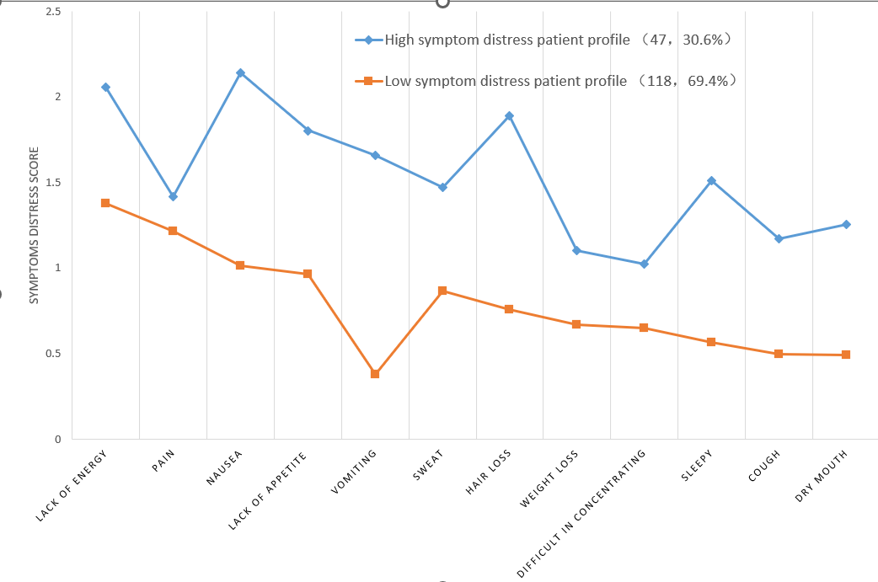
Results
-Two profiles were identified (Entropy=0.828)
high symptom distress patient profile (N= 47,30.6%) (high fatigue -high nausea - high hair loss - high sleepy)
low symptom distress patient profile (N= 118,69.4%) (high fatigue - low nausea - low vomiting - low sleepy)
Figure 2 The means of symptoms distress scores of two-profile model

Slide 12
Results
- Children who suffered higher symptoms profile reported lower light physical activity(LPA)and total physical activity(TPA) (P<0.001) than those who were in lower symptom profile. There was no significant difference of low moderate-to-vigorous physical activity (MVPA) between those two profiles(P=0.164).
Table 5 Difference in physical activity level among patient profiles （N=165）
Profiles | low symptom distress patient profile （high fatigue - low nausea - low vomiting - low sleepy） (N = 118) | high symptom distress patient profile (high fatigue -high nausea - high hair loss - high sleepy) (N=47) | Z | P
PA | 2447.50 (1572.50, 3598.75) | 3305.00 (2205.00, 4268.00) | -2.390 | 0.017*
LPA | 2311.00 (1491.25, 3235.00) | 2915.00 (2205.00, 4025.00) | -2.628 | 0.009**
MVPA | 70.00 (20.00, 196.25) | 27.00 (0.00, 210.00) | -1.391 | 0.164

Slide 13
Conclusions
There is population heterogeneity between the multi-symptoms distress and have negative impact on physical activity levels.
This information provide evidence for precise and individualized intervention for better prevent symptoms and promote the physical activity during the treatment.
This could help to place children within a profile and perhaps allow nurses to provide targeted supportive care to match a child’s specific symptom profile and physical activities.

Slide 14
Selected References
[1]Steliarova-Foucher E, Colombet M, Ries LAG, et al. International incidence of childhood cancer, 2001-10: a population-based registry study[J]. Lancet Oncol. 2017,18(6):719-731.
[2]Chen W, Zheng R, Zhang S, et al. Report of incidence and mortality in China cancer registries, 2009. Chin J Cancer Res. 2013,25(1):10-21.
[3]Ni X. National Children's Cancer Monitoring Annual Report 2020 [M], Beijing: People's Health Publishing House, 2021.
[4]Rodgers C, Hooke MC, Ward J, Linder LA. Symptom Clusters in Children and Adolescents with Cancer. Semin Oncol Nurs. 2016,32(4):394-404.
[5]Berdan CA, Tangney CC, Scala C, Stolley M. Childhood cancer survivors and adherence to the American Cancer Society Guidelines on Nutrition and Physical Activity[J]. J Cancer Surviv. 2014,8(4):671-9.
[6]Wu WW, Yu TH, Jou ST, et al. Physical activity self-efficacy mediates the effect of symptom distress on exercise involvement among adolescents undergoing cancer treatment[J]. Eur J Cancer Care (Engl). 2019,28(4): e13045.
[7]Buckner T W, Wang J, Dewalt D A, et al. Patterns of symptoms and functional impairments in children with cancer.[J]. Pediatric Blood & Cancer, 2014, 61(7):1282-1288.
[8]Wang J, Wang X. Structural Equation Modeling: Applications Using Mplus[M]. Wiley Publishing, 2012.290-318
[9]Götte M，Kesting S，Winter C，et al. Comparison of self-reported physical activity in children and adolescents before and during cancer treatment[J]. Pediatric Blood & Cancer，2014，61(6): 1023- 1028.
[10]Wu WW, Lin KC, Liang SY, Jou ST. Using a Patient-Centered Approach to Identify Symptom Clusters Among Adolescents With Cancer. Cancer Nurs. 2019,42(3):198-207.
[11]Wang J, Jacobs S, Dewalt DA, et al. A Longitudinal Study of PROMIS Pediatric Symptom Clusters in Children Undergoing Chemotherapy. J Pain Symptom Manage. 2018,55(2):359-367.
[12]Ameringer S, Elswick RK Jr, Shockey DP, et al. A pilot exploration of symptom trajectories in adolescents with cancer during chemotherapy. Cancer Nurs. 2013,36(1):60-71

Slide 15
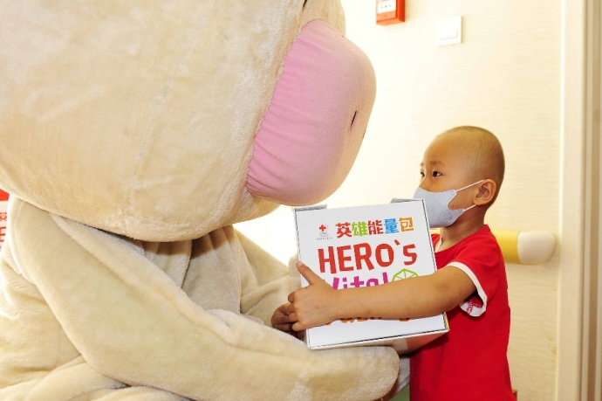
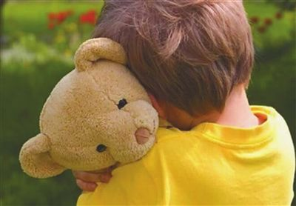

Acknowledgement
Thanks for the cooperation and support from the children and parents participated in this study
This work was supported by the National Natural Science Foundation of China (Youth Program) (Grant No. 71704106), Shanghai JiaoTong University School of Medicine, the Nursing Development Program and the Innovative Research Team of High-level Local Universities in Shanghai.
Better Research, Better Care
Yanyan Liu, Lecturer, PhD,RN
School of Nursing, Shanghai JiaoTong University, Shanghai China
Email：Liuyy0621@126.com
Phone Number:(+86)15618993531

