Slide 1


Can Gu, PhD in Nursing, Postdoctoral Fellow in Clinical Medicine, Professor, PhD candidate’s supervisor, graduated from the Chinese University of Hong Kong with a PhD in Nursing in 2010, and conducted postdoctoral research at Yale School of Public Health and Yale School of Nursing in 2012 and 2014, respectively. Dean.
As the PI of 2 projects of the National Natural Science Foundation of China, 1 open competition project from China Medical Board, and 10 provincial and international cooperation projects.
A member of the expert pool of the 28th Council of the Chinese Nursing Association's Surgical Nursing Committee, a member of the Hunan Provincial Nursing Association's Oncology Nursing Committee, an expert in the Nursing Group of the Hunan Maternal and Child Health and Eugenics Association's Expert Committee, and a standing member of the Hunan International Medical Exchange Promotion Association's Respiratory Disease Committee. A member of the international editorial board of Asia-Pacific Journal of Oncology Nursing.

Slide 2


Patient delay and related influencing factors in Chinese women under 40 years diagnosed with breast cancer: A cross-sectional study
Dr.Gu Can
The Xiangya School of Nursing
Central South University

Slide 3

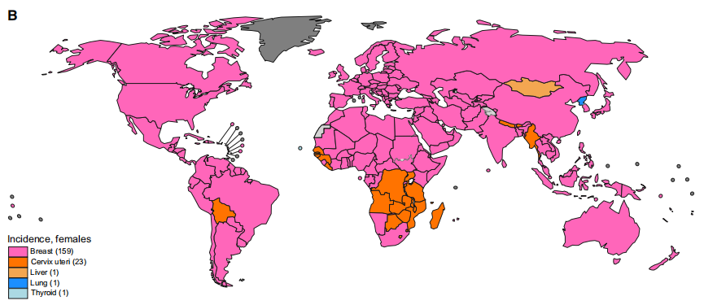
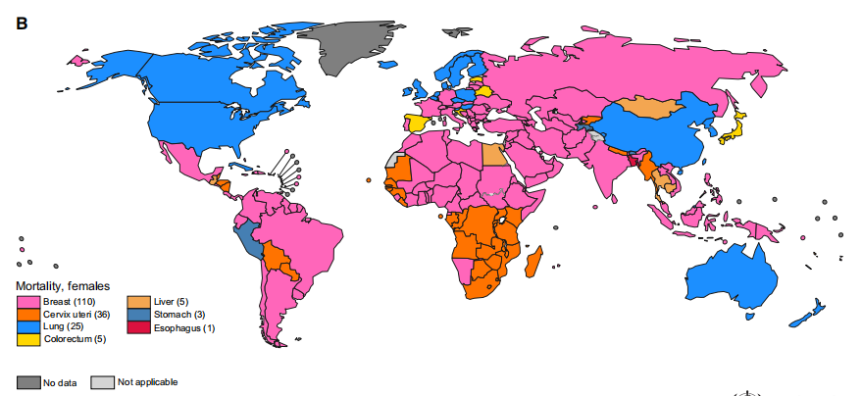
Introduction
Breast cancer is the most common cancer in women and severely threatens women’s health. China contributes to more than 20% of the global breast cancer burden, with 420,000 cases and 120,000 deaths.
Incidence, female
The patient delay (PD) of breast cancer patients leads to further tumor enlargement, increased occurrence of distant metastasis, and higher TNM staging. Therefore, further deterioration of cancer caused by long-term patient delay makes young women bear more treatment burden and face a more severe survival dilemma.
Mortality, female

Slide 4
Introduction
The Behavioral Model of Health Services Utilization (BMHSU) provides a specific path for understanding the personal and external resource factors of patient delays.
Predisposing factors
the likelihood that an individual will need health care services
an individual’s ability to access health care services and the availability of health care services
BMHSU
Enabling factors
Need factors
an individual’s perceived need for health care services
The BMHSU hypothesizes the relationship between health behaviors and health outcomes: health behaviors influence health outcomes. Therefore, it is also reasonable to hypothesize that patient delay may influence the quality of life (QoL) in young breast cancer patients.

Slide 5

Objective
Investigate the patient delay rate in young breast cancer patients in China and to explore factors associated with patient delay among this population
The specific objectives:
investigate the patient delay rate
analyze its main influencing factors in breast cancer patients
analyze the influence of patient delay on disease characteristics and QoL in breast cancer patients

Slide 6
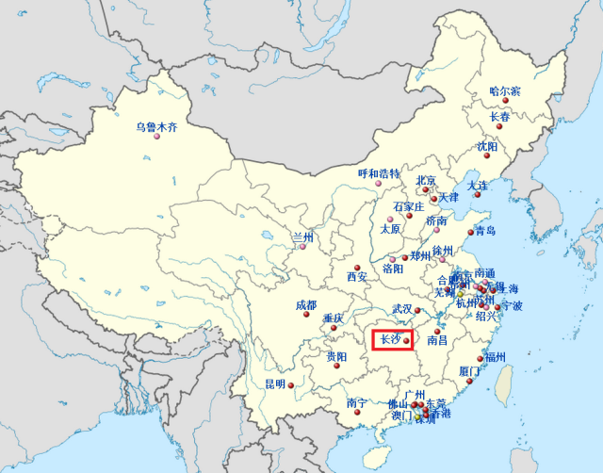




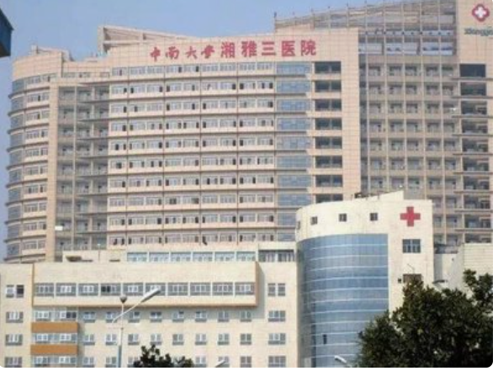
Methods
October 2022 and March 2023
Convenience sampling method
Inclusion criteria:
(a) 40 years old or less,
(b) diagnosis of breast cancer confirmed by clinical and pathological examination,
(c) literate and able to communicate in Mandarin,
(d) patients having agreed to participate in the study.
Exclusion criteria:
(a) participating in or having participated in similar studies in the past; (b) had severe physical or mental illness and inability to cooperate with the investigation.

Slide 7
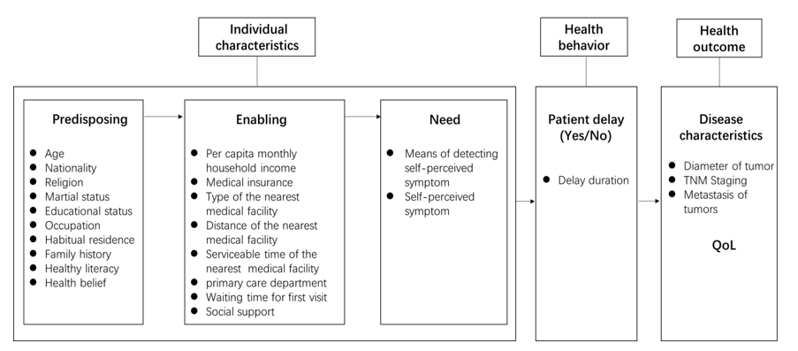
Methods
The key variable was the rate of patient delay (which was classified as to whether a delay in symptom presentation) of young breast cancer patients. The exact time, length and self-reported reasons of delay were also recorded.
BMHSU Model

Slide 8



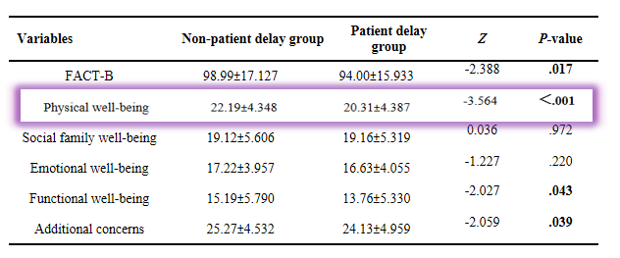
Results
Table 2 The influence of patient delay on disease characteristics
Variables | Non-patient delay groupn（%） | Patient delay group n（%） | χ² | P-value
Tumor diameter |  |  | 7.304 | .026
≤2cm | 94（52.2） | 41（38.7）
>2cm，≤5cm | 71（39.4） | 47（44.3）
>5cm | 15（8.3） | 18（17.0）
TNM Staging
0 | 3（1.7） | 0（0.0） | 4.321 | .364
Ⅰ | 40（22.2） | 20（18.9）
Ⅱ | 87（48.3） | 50（47.2）
Ⅲ | 23（12.8） | 21（19.8）
Ⅳ | 27（15.0） | 15（14.2）
Lymphatic metastasis |  |  | 4.226 | .040
No | 87（48.3） | 38（35.8）
Yes | 93（51.7） | 68（64.2）
Distant metastasis |  |  | 0.440 | .507
No | 151（83.9） | 92（86.8）
Yes | 29（16.1） | 14（13.2）
Table 1 Risk factors of patient delay in young breast cancer patients
Variables | OR | 95% CI | P-value
Residence
Rural | 3.676 | 1.468 -9.206 | .005
Urban | Ref. | Ref.
First visit department
Ultrasound imaging department | 1.932 | 0.805-4.636 | .140
Gynecology department | 2.845 | 0.774-10.447 | .115
Other | 3.910 | 1.439-10.624 | .008
Breast specialty | Ref. | Ref.
Waiting time for first visit
＞7 days | 11.350 | 3.450 -37.345 | ＜.001
≤7days | Ref. | Ref.
Means of detecting symptoms
Routine physical examination | .208 | 0.045-0.967 | .045
Free breast cancer screening | .131 | 0.010 -1.686 | .119
Symptoms discovered by accident | Ref. | Ref.
Critical healthy literacy | .676 | 0.506 -0.904 | .008
Friend support | .921 | 0.855-0.993 | .033
Table 3 The influence of patient delay on QoL

Slide 9
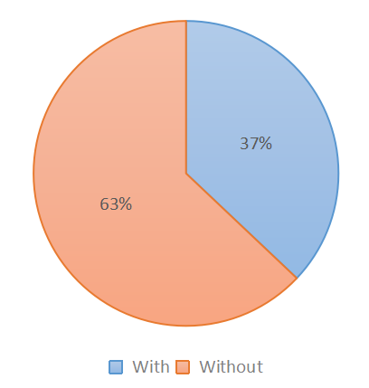
Discussion
Main findings
37.06%
37.06% of the respondents had patient delay, which is much higher than in developed countries such as the United States, Germany, and the United Kingdom (12-30%).
And the result is moderate compared with other developing countries such as Mexico, Iran, Vietnam, and Morocco (20-70.1%).
The delay time for the young breast cancer patients in this study ranged from 1 to 2,160 days, with a median delay time of 30 days.
This delay in the consultation was lower than six months in Morocco, lower than 5.5 months in Vietnam, much higher than ten days in Mexico, and much higher than 16 days in Germany.

Slide 10
Discussion
Risk factors of patient delay in young women with breast cancer
A
Waiting time of the first outpatient appointment >7 days
B
First diagnosis department
C
Rural residence
Chinese residents tend to senior hospitals for severe and minor diseases,contributing to the long waiting times for appointment registration, which may result in patient delays.
Some patients were willing to the Chinese medicine department and receive long-term treatment; some were willing to consult a general practitioner in a community hospital.
However, these practitioners may have insufficient knowledge and diagnosis experience related to breast diseases.
They may ignore abnormal symptoms due to a lack of correct knowledge.
The long distance to medical health institutions, which fails to meet rural patients' healthcare needs.
Hunan is a multiethnic region; young women are influenced by the religious culture of their ethnicity.

Slide 11
Discussion
Risk factors of patient delay in young women with breast cancer
D
Critical healthy literacy
E
Family support
F
Routine physical examination
The contemporary younger group generally has a higher level of education than their older counterparts.
This group has more critical thinking about health information, which explain a more significant role of health literacy in patient delay for young patients relative to older patients.
This is probably because the private nature of the breast, young patients are more inclined to disclose their symptoms to their female friends.
Some patients feared that the breast lesions would break their relationship with their husbands, which led to patient delay.
Abnormal signs can be detected in time through clinical breast examination, breast ultrasonography, ad other auxiliary examination.
In addition, physical examinations have complete post-examination services and in-hospital referral pathways, which can shorten the consultation time.

Slide 12


Discussion
Impact of patient delay on disease characteristics and QoL
Tumor enlargement and lymph node metastasis
Tumor growth rate of breast cancer is age-related, with shorter pre-clinical sojourn time and faster tumor growth rate in younger women.
Poor QoL
Patients in the patient delay group may undergo a more aggressive treatment regimen (e.g., axillary-lymph-node dissection, modified radical mastectomy) due to larger tumor diameter with lesion status. These patients are more likely to experience decreased physical activity, muscle strength, and lymphedema after surgery.

Slide 13

Conclusions
Patient delay for young breast cancer patients is not encouraging.
Individual characteristics and social environment factors, such as the accessibility of health care resources and social support, influence patient delay of young breast cancer patients. In addition, an individual’s level of symptom perception is also an essential factor influencing patient delay. These findings reinforce that the importance of healthcare services in breast cancer prevention needs to be emphasized.
Patient delay is associated with poor clinical outcomes and QoL in young breast cancer patients.
Clinical services should be optimized to incorporate the diverse needs of young breast cancer patients to improve survival in this population.

Slide 14


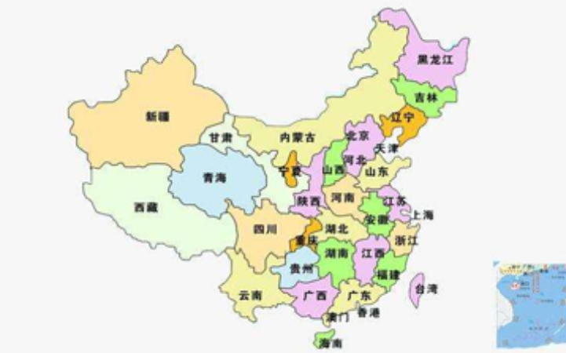



Changsha, Hunan Province, China
Located in the Central of China, with many historic Sites and pleasent scenery

Slide 15


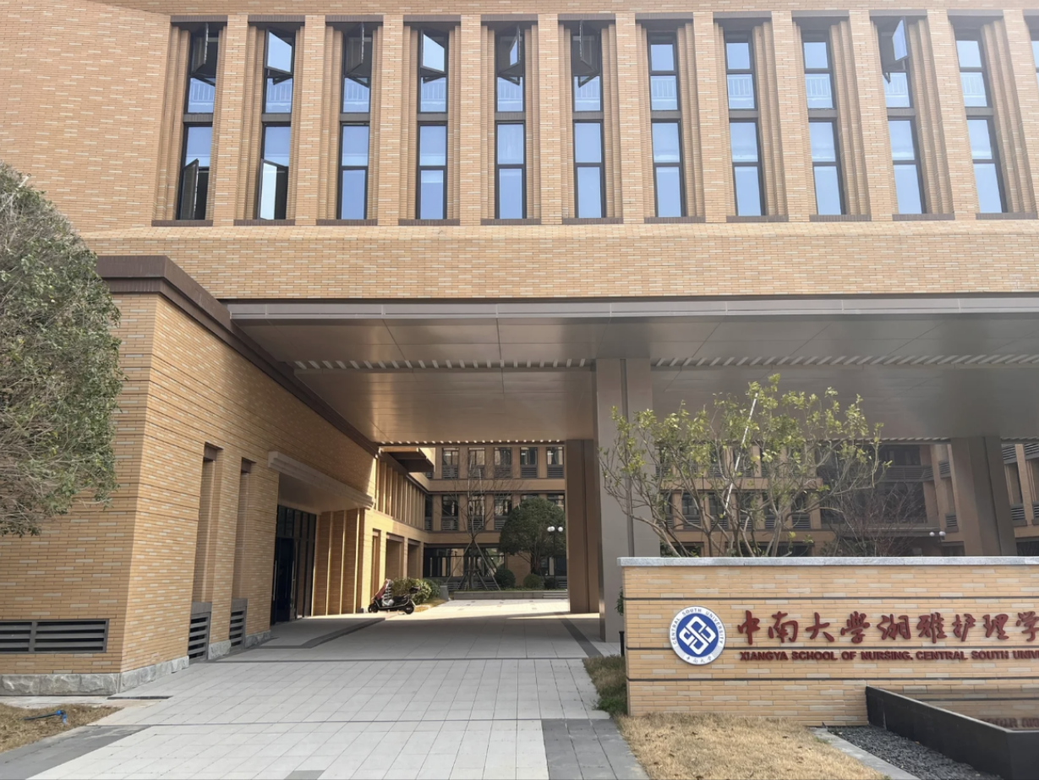


Xiangya School of Nursing
Central South University
Xiangya School of Nursing of Central South University (CSU) was founded in 1911 by the Yale-China Association. The school is the one of the earliest colleges and universities in China to provide nursing education.

