Slide 1


The development and effectiveness of a complex family adaptation intervention strategies among Chinese families of hospitalized child with cancer: A research protocol
Author(s): Can GU¹; Yilin Zhang¹;
Affiliation(s):1 Xiangya School of Nursing, Central South University, Changsha, China.

Slide 2

Introduction
China has the second highest number of new cases in the world,the incidence rate in China is increasing significantly at an annual rate of 2.8%, much higher than the 0.6% in the United States and 1.1% in Europe.
A child newly diagnosed with cancer often needs to be hospitalized for related treatment. The experience of hospitalizing a child with cancer often has a negative impact on the physical and mental health of the child and family members.
Researchers have continued to focus their studies of children with cancer on survival, and there is a lack of research on newly diagnosed hospitalized children.

Slide 3
Introduction
Psychosocial interventions for children with cancer include CBT or BT-based interventions, therapeutic play, and art therapy,etc. These interventions have achieved positive results, but there are still some problems, such as higher dropout rates, lower adherence, and lower applicability to preschoolers, ignoring the role of affectionate attachment and family functioning in pediatric oncology care.
The Integrative Model of Pediatric Medical Traumatic Stress(PMTS), noting that post-diagnosis families with childhood cancer are in a period of acute response to a medical trauma event, and the need for appropriate psycho-social interventions.

Slide 4
Introduction
Kazak's team has developed multi-component intervention based on family therapy and cognitive behavioral therapy for children with cancer.
Considering the unique sociocultural context and health care delivery system in China determines the specificity of the adaptation process for families of hospitalized children with cancer.
The quality of culturally-based, multi-component interventions for families of hospitalized children with cancer in China is limited by the lack of evidence.

Slide 5
Objective
Overall Objectives
To develop and validate the effectiveness of a complex family adaptation intervention strategy among families for cancer in hospitalized children in China.

Slide 6
Objective
Specific objectives:
(1) to develop the complex intervention strategy based on the Medical Research Council (MRC) complex intervention conceptual framework.
(2) to evaluate the effectiveness of complex intervention strategy in improving key and secondary indicators.
(3) to explore the contribution of family adaptation process variables and primary moderating variables to changes in primary and secondary indicators for children and caregivers, respectively.
(4) to assess the clinical applicability of the complex intervention strategy.

Slide 7
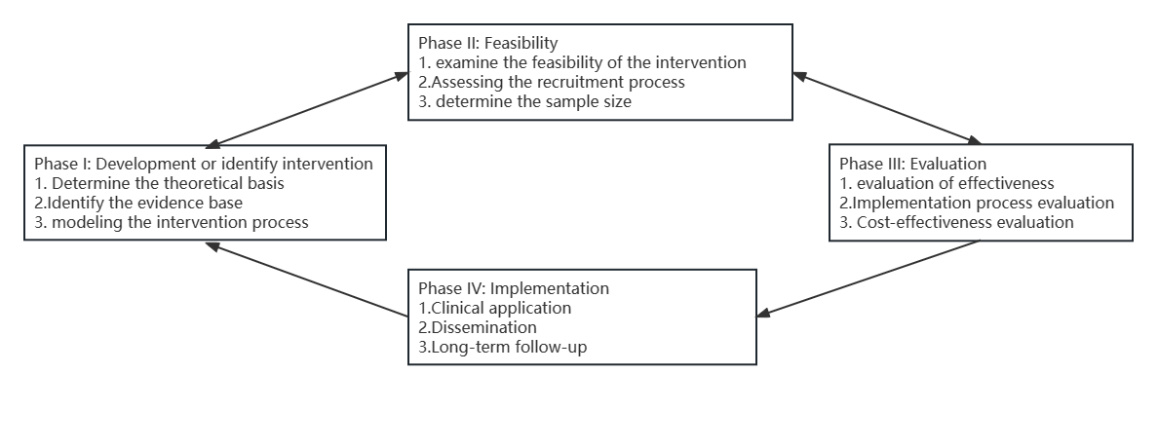
Methods
The study will follow the first three phases described by the MRC framework.
Figure1. Project development and evaluation process based on the Medical Research Council's Complex Interventions Framework

Slide 8
Methods
In phase I, the development of complex intervention strategy.
In phase II, pre-experiment of the complex intervention strategy.
In phase III, is a cluster randomized clinical trial to evaluate the application and effectiveness of a family-adapted complex intervention strategy.

Slide 9
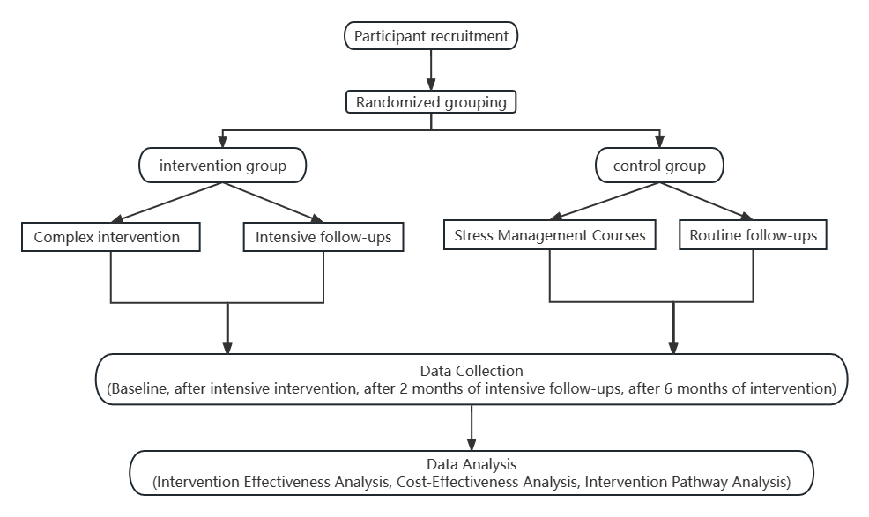
Methods
Figure 2.Flow diagram of study design

Slide 10
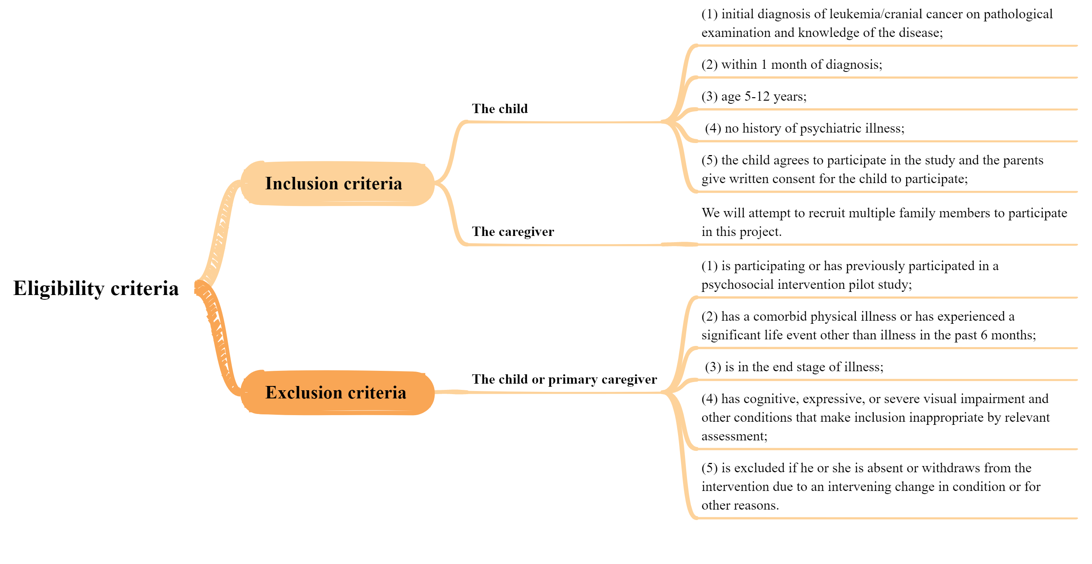
Methods

Slide 11
Methods
Table1. Preliminary protocol for complex intervention strategies
Time | Course
Day 1 (90min): | How does cancer affect me and my family?
Day 2 (90min): | How do we deal with cancer?
Day 3 (90min): | Families work together to face the future.

Slide 12
Outcome
Table 2. Outcome data collection plan
Assement tool | T0=baseline | T1=post- intervention | T2=2 months follow-up | T3= 6 months follow-up
Demographic data | A,B
Family Adaptability Cohesion Environment Scale（FACES II-CV） | A | A | A | A
Posttraumatic Stress Disorder Reaction Index(PTSD-RI) | B | B | B | B
the Impact of Event Scale-6(IES-6) | A | A | A | A
the Positive and Negative Affect Scale(PANAS) | B | B | B | B
the Drepression Anxiety Stress Scale-21(DASS-21) | A | A | A | A
the Euro Qol five-dimension questionnaire (EQ-5D) | A | A | A | A
the Euro Qol five-dimension Youth version scale (EQ-5D-Y) | B | B | B | B
FamilyInventoryofLifeEventsandChanges(FILE) | A | A | A | A
SocialSupportRatingScale(SSRS) | A | A | A | A
Simplified Coping Style Questionnaire (SCSQ) | A | A | A | A
ChildPosttraumaticCognitionsInventory(CPTCI) | B | B | B | B
theStressAppraisalMeasure(SAM) | A | A | A | A
Disease progression and regression | B | B | B | B
Sleeping conditions | A,B | A,B | A.B | A,B
Salivary cortisol concentration | A,B | A,B | A,B | A,B
Semistructured interviews |  | B,C
A,caregives;B,patients;C,intervention researchers

Slide 13
Discussion
Family functioning is associated with patients' health-related quality of life, illustrating the importance of assessing adaptation in the family setting and supporting further research on psychosocial screening and interventions for pediatric cancer patients in the family context.
Existing researches have been conducted to show the applicability of multi-component intervention strategies for families of children with cancer and the favorable positive effects on promoting family mental health. Of these, only the SCCIP-ND program has been used with families of newly diagnosed children with cancer and suffers from small sample sizes, long intervention cycles, and high rates of lost visits.

Slide 14
Discussion
In our study, the complex family adaptation intervention strategy among families in hospitalized children with cancer will use a short-cycle multi-component intervention, and utilizing a 3-day intervention and 2-month follow-up intervention can effectively improve participant adherence and reduce the rate of disenrollment.
At the same time, research on pediatric oncology patients will be conducted on a family basis, focusing on interventions for psychosocial conditions in the family environment.

Slide 15
References
[1] International agency for research on cancer.estimated number of new cases in 2020, all cancers, both sexes, ages 0-14[EB/OL]. https://gco.iarc.fr/today/home.
[2] ZHENG R, PENG X, ZENG H, et al. Incidence, mortality and survival of childhood cancer in china during 2000-2010 period: a population-based study[J]. Cancer Letters, 2015,363(2): 176-80.
[3] SPOSITO A M, SILVA-RODRIGUES F M, SPARAPANI V C, et al. Coping strategies used by hospitalized children with cancer undergoing chemotherapy[J]. Journal of Nursing Scholarship, 2015,47(2): 143-51.
[4] JUDAN T, HUAYING Y, TUO M, et al. Psychological and behavioral problems of hospitalized children with common chronic diseases in school age and their main influencing factors[J]. Evidence-Based Nursing, 2021,7(07): 915-9.
[5] AO X. A practical study on improving the family education of hospitalized children with leukemia[D]. Yunnan University, 2021.
[6] WARD Z J, YEH J M, BHAKTA N, et al. Global childhood cancer survival estimates and priority-setting: a simulation-based analysis[J]. Lancet Oncology, 2019,20(7): 972-83.
[7] KAZAK A E, KASSAM-ADAMS N, SCHNEIDER S, et al. An integrative model of pediatric medical traumatic stress[J]. Journal of Pediatric Psychology, 2006,31(4): 343-55.
[8] SATAPATHY S, KAUSHAL T, BAKHSHI S, et al. Non-pharmacological interventions for pediatric cancer patients: a comparative review and emerging needs in india[J]. Indian Pediatrics, 2018,55(3): 225-32.
[9] SANSOM-DALY U M, WAKEFIELD C E, BRYANT R A, et al. Online group-based cognitive-behavioural therapy for adolescents and young adults after cancer treatment: a multicenter randomised controlled trial of recapture life-aya[J]. Bmc Cancer, 2012,12: 339.
[10] BOONSTRA A, GIELISSEN M, van DULMEN-DEN B E, et al. Cognitive behavior therapy for persistent severe fatigue in childhood cancer survivors: a pilot study[J]. Journal of Pediatric Hematology Oncology, 2019,41(4): 313-8.
[11] HALL B C, SHORT V M, GIBERSON S, et al. A cognitive behavioral therapy group for adolescent and young adult cancer patients: a review of a pilot program[J]. Journal of Adolescent and Young Adult Oncology, 2020,9(3): 422-5.
[12] PING Z. Effects of cognitive behavior therapy on negative emotion and immune function in adolescent patients with cancer[D]. Chongqing Medical University, 2019.
[13] PAI A L, GREENLEY R N, LEWANDOWSKI A, et al. A meta-analytic review of the influence of pediatric cancer on parent and family functioning[J]. Journal of Family Psychology, 2007,21(3): 407-15.
[14] CHENG K K, TAN L. A pilot study of the effect of a home-based multimodal symptom-management program in children and adolescents undergoing chemotherapy[J]. Cancer Reports, 2021,4(3): e1336.
[15] EBRAHIMI E, MIRZAIE H, SAEIDI B M, et al. The effect of filial therapy on depressive symptoms of children with cancer and their mother's depression, anxiety, and stress: a randomized controlled trial[J]. Asian Pac J Cancer Prev, 2019,20(10): 2935-41.
[16] XIAORONG P, LIN M, QIAN L, et al. Construction and application of family positive behavior support program[J]. Chinese Journal of Nursing, 2021,56(11): 1618-26.
[17] KAZAK A E, ALDERFER M A, STREISAND R, et al. Treatment of posttraumatic stress symptoms in adolescent survivors of childhood cancer and their families: a randomized clinical trial[J]. Journal of Family Psychology, 2004,18(3): 493-504.
[18] SALEM H, KAZAK A E, ANDERSEN E W, et al. Home-based cognitive behavioural therapy for families of young children with cancer (famos): a nationwide randomised controlled trial[J]. Pediatric Blood & Cancer, 2021,68(3): e28853.
[19] KAZAK A E, SIMMS S, ALDERFER M A, et al. Feasibility and preliminary outcomes from a pilot study of a brief psychological intervention for families of children newly diagnosed with cancer[J]. Journal of Pediatric Psychology, 2005,30(8): 644-55.
[20] XINYI X, XIAORONG M, YATING Y, et al. Research progress on the care burden of family caregivers of children with cancer[J]. Guangxi Medical Journal, 2023,45(08): 968-72.
[21] AL G N, STEVENS E, VELÁZQUEZ-MARTIN B, et al. Family factors and health-related quality of life within 6 months of completion of childhood cancer treatment[J]. Psycho-Oncology, 2021,30(3): 408-16.

