Slide 1


Factors affecting colonoscopy screening among first-degree relatives of colorectal cancer patients: A mixed-method systematic review
Author(s)：Rujin Li¹，Caixia Li²，Li Liu³，Weicong Chen¹，Yang Bai¹*
Affiliation(s)：1 School of Nursing, Sun Yat-sen University, Zhongshan 2 Rd 74#, Guangzhou, Guangdong, P.R. China
2 The Nethersole School of Nursing, The Chinese University of Hong Kong, Horse Material Water, Shatin, New Territories, Hong Kong SAR, China
3 School of Nursing, Central South University, No.932 South Lushan Road, Changsha, P.R. China

Slide 2

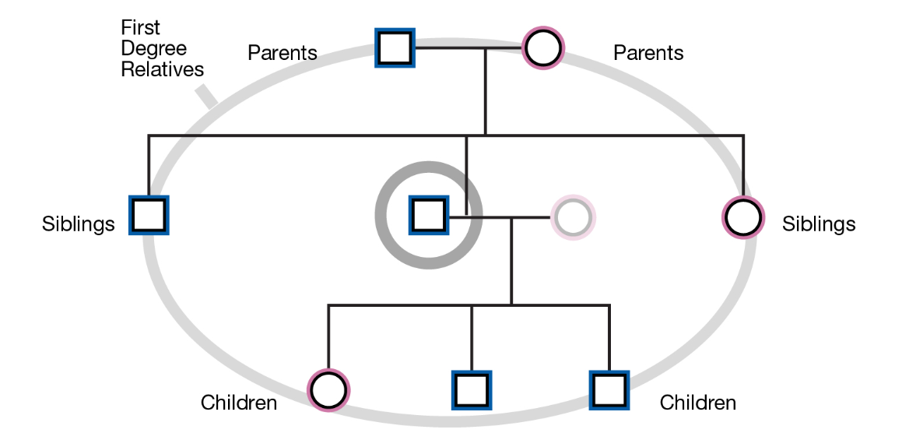

Introduction
Notes:
First-degree relatives (FDRs) of people with colorectal cancer (CRC) have an increased risk of developing the disease, ranging from two to three-fold higher compared to the general population (Keum & Giovannucci, 2019).
Ensuring that these at-risk populations receive appropriate screening tests is an effective strategy for reducing the increased risk (Rabeneck et al., 2020).

Slide 3
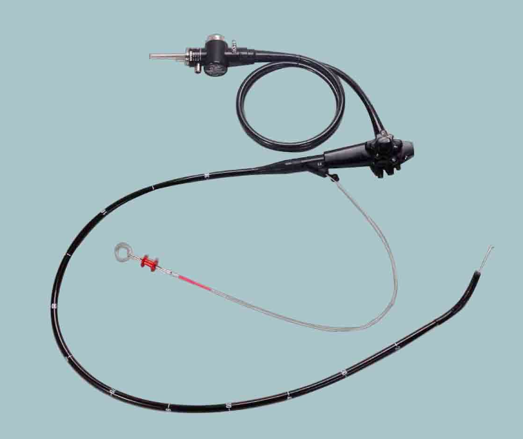
Introduction
looking at the inside of the colon and rectum
removing adenomatous polyps and the precursors of CRC at the same time
Colonoscopy
Notes:
In fact, colonoscopy is the best screening option for FDRs because it enables prevention, rather than early detection, by allowing the removal of preneoplastic lesions
Compared with other screening tests, colonoscopy is a more appropriate option for at-risk populations (Lauby-Secretan et al., 2018) given that the procedures involve removing adenomatous polyps and the precursors of CRC at the same time (Doubeni et al., 2018).

Slide 4
Introduction
Although various screening guidelines recommend colonoscopy for at-risk populations, the adherence rate to this advice is under 50% (range, 31%-47%)
Besides, FDRs’ colonoscopy screening is even lower, under 20% (range, 15.6-18.9%)
Lowery et al., (2016). Understanding the contribution of family history to colorectal cancer risk and its clinical implications: A state-of-the-science review. Cancer
Bai et al., (2020). Colonoscopy Screening Behaviour and Associated Factors Amongst First-Degree Relatives of People with Colorectal Cancer in China: Testing the Health Belief Model Using a Cross-Sectional Design
Notes:
Although various screening guidelines recommend colonoscopy for at-risk populations, the adherence rate to this advice is under 50% (range, 31%-47%) (Lowery et al., 2016). Nonparticipation in colonoscopy screening may lead to a series of adverse consequences, such as the diagnosis of cancer at an advanced stage or death from CRC (Beshara et al., 2020). The associated factors should be explored to deepen the understanding of colonoscopy as an underutilized screening method among FDRs and develop subsequent interventions to enhance their adherence.

Slide 5
Introduction
Research gap
FDRs are often asymptomatic and need more motivation to receive invasive tests than general populations.
Meanwhile, colonoscopy is more invasive and complex than stool-based screen tests.
Only one review summarized the qualitative studies, which may result in missing some critical factors identified by quantitative studies.
Notes:
Although various systematic reviews have synthesized the factors influencing CRC screening (Dressler et al., 2021; Kerrison et al., 2021; Tan et al., 2018), few of them target on FDRs and colonoscopy (Tan et al., 2018).

Slide 6



Introduction
Individual factors
Communication
Policy
Notes:
Furthermore, colonoscopy screening behavior is affected not only by individual factors but also by factors at multiple levels.

Slide 7
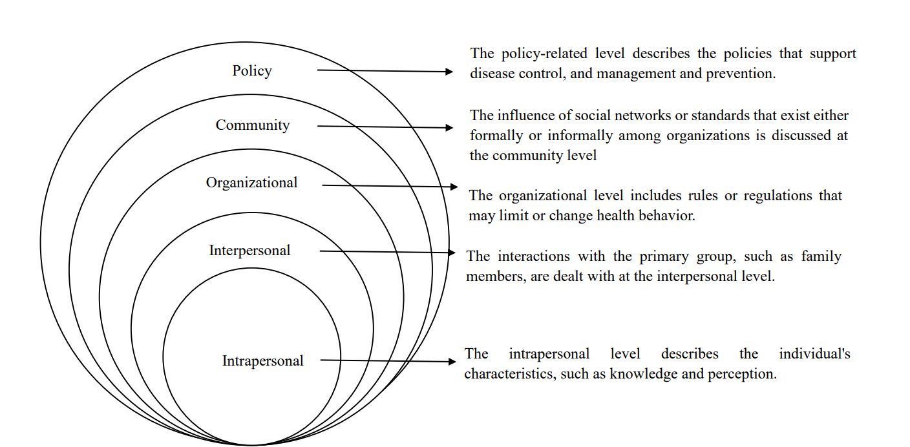
Objective
The ecological model

Slide 8
Objective
To explore factors influencing FDRs’ colonoscopy screening behavior according to the ecological model.

Slide 9
Methods
The Preferred Reporting Items for Systematic Reviews and Meta-analyses (PRISMA) guidelines.
Database: Medline, EMBASE, PubMed, the Cochrane Library, Scopus, China National Knowledge Infrastructure, Wan Fang Data, and China Biology Medicine
The Joanna Briggs Institute (JBI) critical appraisal checklists
Data synthesis and integration: A convergent integrated approach
Page et al., (2021). The PRISMA 2020 statement: an updated guideline for reporting systematic reviews.
Lockwood et al., (2015) Qualitative research synthesis: methodological guidance for systematic reviewers utilizing meta-aggregation.
Stern et al., (2020). Methodological guidance for the conduct of mixed methods systematic reviews.

Slide 10
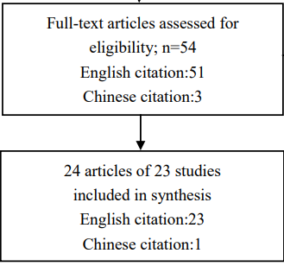
Results
All 17 quantitative studies were rated as moderate to high quality. Among the 6 qualitative studies, 5 were rated as moderate to high study quality, and 1 qualitative was rated as low quality.
A total of 9234 FDRs were included across the 23 studies from 1998 to 2022. Of the 23 included studies, most were conducted in Asia, followed by Europe, and America.

Slide 11
Results
Policy-related level
Community-based level
Organizational level
Interpersonal level
Intrapersonal level
Colonoscopy screening
Cost(-)
Fear of CRC(-)
Physicians’ recommendations(+)
Misconceptions about CRC and colonoscopy(-)
- Negative
+ Positive
Health motivation(+)
Colonoscopy schedules(-)
Fatalism(-)
Cancer taboo(-)
Recommendations from CRC patients(+)
Perceived susceptibility(+)
Concerns about the procedure(-)
Health insurance(+)
The proposed full model of the ecological model
Notes:
The recommendation from patients was one of the most important factors, given most of the included studies indicated it related to FDR’s colonoscopy screening behavior. Meanwhile, it held a core position and interacted with different levels of factors.
Based on communication through family networks, FDRs would receive recommendations from CRC patients on family history-based cancer risk and the potential benefits of screening.
The role of this factor has not been made clear in previous reviews to summarize factors associated with colonoscopy behavior for other populations.

Slide 12
Misconceptions
The screening tests should be received when they have symptoms.
Fecal occult blood tests (FOBTs), or normal routine physical examinations could replace colonoscopy screening
A balanced diet and regular physical exercise guaranteed good health and there was no need to undergo screening
Chouhdari et al.,(2019). The Relationship Between Lifestyle and Compliance with Colonoscopy in First-Degree Relatives of Patients with Colorectal Cancer.
McGarragle et al.,(2019). Examining intrafamilial communication of colorectal cancer risk status to family members and kin responses to colonoscopy: a qualitative study.

Slide 13
Concerns about the procedure
Inconvenience
Pain or discomfort
Bowel preparation
Transportation

Slide 14
Discussion
The first mixed-method systematic review examines factors associated with colonoscopy screening behavior among FDRs based on the ecological model.
Five main types of factors (intrapersonal, interpersonal, organizational, community, and policy) and interactions across multiple factors were identified.
Notes:
Therefore, family-centered multiple-level interventions to promote screening behavior are recommended for programs targeting at-risk family members, especially for the culture system that values family.
However, the role of this factor has not been made clear in previous reviews to summarize factors associated with colonoscopy behavior for other populations.

Slide 15
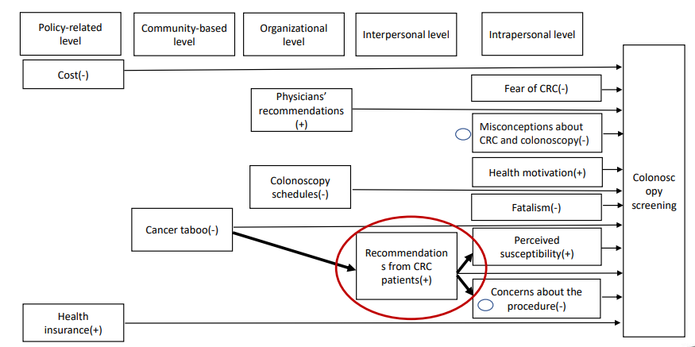
Discussion
Notes:
The recommendation from patients was one of the most important factors, given most of the included studies indicated it related to FDR’s colonoscopy screening behavior. Meanwhile, it held a core position and interacted with different levels of factors.
Therefore, family-centered multiple-level interventions to promote screening behavior are recommended for programs targeting at-risk family members, especially for the culture system that values family.

Slide 16
Discussion
Family history-based cancer risk and the potential benefits of screening.
FDRs have a strong life-emotional connection with CRC patients
The real experience of CRC patients, emotional communication, and support in the family,
Besides, some FDRs are the main caregivers of bowel cancer patients.
Notes:
Therefore, family-centered multiple-level interventions to promote screening behavior are recommended for programs targeting at-risk family members, especially for the culture system that values family.
However, the role of this factor has not been made clear in previous reviews to summarize factors associated with colonoscopy behavior for other populations.

Slide 17
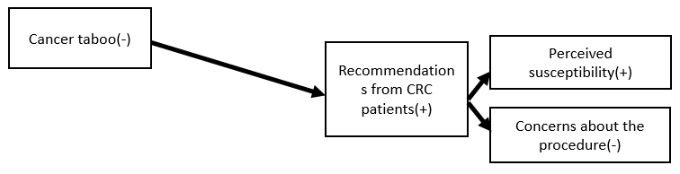
Discussion
Recommendations from patients would
increase their FDRs’ perception of susceptibility.
ease concerns about colonoscopy procedures.
Cancer taboo restricted the recommended behavior of CRC patients.
Notes:
The recommendation from patients was one of the most important factors, given most of the included studies indicated it related to FDR’s colonoscopy screening behavior. Meanwhile, it held a core position and interacted with different levels of factors.
Therefore, family-centered multiple-level interventions to promote screening behavior are recommended for programs targeting at-risk family members, especially for the culture system that values family.

Slide 18
Discussion
However, the fact should not be ignored that the initial task for CRC patients is to treat and fight against disease, when and how to communicate with their at-risk relatives remains unclear and need to be further explored.
Notes:
Therefore, family-centered multiple-level interventions to promote screening behavior are recommended for programs targeting at-risk family members, especially for the culture system that values family.

Slide 19
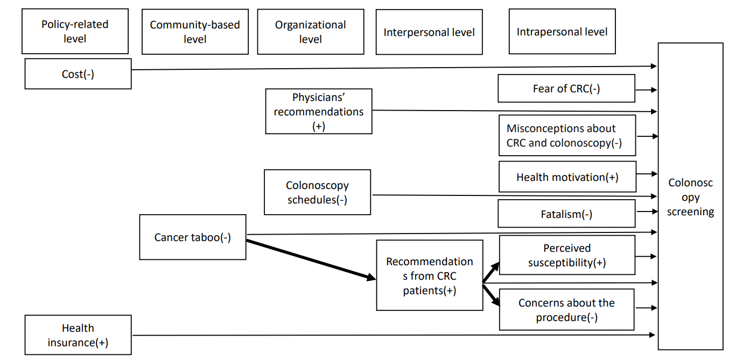
Discussion
Notes:
The health professionals’ recommendation, as an organizational factor was consistently reported to be a facilitator of colonoscopy screening behavior (Kerrison et al., 2021). Nevertheless, limited contact with the FDRs of CRC patients (McGarragle et al., 2019) and extensive workload (Sahota et al., 2015), healthcare providers were prohibited from disclosing cancer risk and screening information to at-risk family members. Additionally, sometimes physicians cannot provide appropriate suggestions, because patients did not disclose their diagnosis to their family members. The responsibility to share cancer risk and screening information lies almost exclusively with the cancer survivors, who has the right not to disclose this information.

Slide 20

Discussion
Limited contact with the FDRs of CRC patients (McGarragle et al., 2019)
Extensive workload (Sahota et al., 2015)
Patients did not disclose their diagnosis to their family members.
Disclosing cancer risk and screening information to at-risk family members

Slide 21
Discussion
Notes:
Therefore, family-centered multiple-level interventions to promote screening behavior are recommended for programs targeting at-risk family members, especially for the culture system that values family.

Slide 22

Discussion
The possible reason is that general knowledge about cancer risk and screening strategies may be not enough to help FDRs identify some common misconceptions and make appropriate decisions.
Apart from general knowledge about cancer risk and screening, decision aids should also be provided to FDRs of CRC patients when they were confused with various screening options.

Slide 23
Discussion
Notes:
Therefore, family-centered multiple-level interventions to promote screening behavior are recommended for programs targeting at-risk family members, especially for the culture system that values family.

Slide 24
Discussion
Three qualitative studies showed that fatalism (+) (Ingrand et al., 2008; Tan et al., 2020; Zhang et al., 2021),
one quantitative study showed fatalism (-) (Taouqi et al., 2010).
In qualitative studies, fatalism =occurrence of cancer is predestined.
In the quantitative study, fatalism = death is inevitable when cancer is diagnosed (Powe & Finnie, 2003).

Slide 25
Discussion
Thus, future studies are suggested to investigate the relationship between colonoscopy screening and fatalism measured with a fatalism scale focused on cancer occurrence, such as the cancer fatalism scale developed by Shen et al. (Shen et al., 2009).
Shen et al., (2009). The psychometric property and validation of a fatalism scale.

Slide 26
Discussion

Slide 27

Discussion
It seems that free or partially covered colonoscopy may promote screening rates among FDRs.
An extremely low screening rate was still reported by Bai et al. in a free-colonoscopy screening program.
Cancer risk- and screening-related information support.

Slide 28
Conclusions
The detailed classification supplements the findings from previous reviews by identifying new factors and interpreting interactions between factors.
Family communication-centered multilevel interventions are recommended for future CRC screening promotion programs for at-risk FDRs of CRC patients.

Slide 29
Conclusions
Decision aids are recommended for FDRs of CRC patients with confusion about multiple options.
Future studies are suggested to define fatalism from the aspect of the occurrence of cancer, using the instrument of the cancer fatalism scale developed by Shen et al. (Shen et al., 2009)

Slide 30


Strength and limitations
This review only concentrated on FDRs and their colonoscopy screening behavior.
Secondly, both qualitative and quantitative studies were included in this review.
We did not include gray literature.
We excluded some studies that explored factors of both colonoscopy and other stool tests.

Slide 31
References
-Adakan, Y., Taskoparan, M., Cekin, A. H., Duman, A., Harmandar, F., Taskin, V., Yilmaz, U., & Yesil, B. (2014). Implementation of screening colonoscopy amongst first- degree relatives of patients with colorectal cancer in Turkey: a cross-sectional questionnaire based survey. Asian Pac J Cancer Prev, 15(14), 5523-5528. https://doi.org/10.7314/apjcp.2014.15.14.5523
- Beshara, A., Ahoroni, M., Comanester, D., Vilkin, A., Boltin, D., Dotan, I., Niv, Y., Cohen, A. D., & Levi, Z. (2020). Association between time to colonoscopy after a positive guaiac fecal test result and risk of colorectal cancer and advanced stage disease at diagnosis. Int J Cancer, 146(6), 1532-1540. https://doi.org/10.1002/ijc.32497
- Bronner, K., Mesters, I., Weiss-Meilik, A., Geva, R., Rozner, G., Strul, H., Inbar, M., Halpern, Z., & Kariv, R. (2013). Determinants of adherence to screening by colonoscopy in individuals with a family history of colorectal cancer. Patient Educ Couns, 93(2), 272-281. https://doi.org/10.1016/j.pec.2013.06.029
- Bujanda, L., Sarasqueta, C., Zubiaurre, L., Cosme, A., Munoz, C., Sanchez, A., Martin, C., Tito, L., Pinol, V., Castells, A., Llor, X., Xicola, R. M., Pons, E., Clofent, J., de Castro, M. L., Cuquerella, J., Medina, E., Gutierrez, A., Arenas, J. I., Jover, R., & Group, E. (2007). Low adherence to colonoscopy in the screening of first-degree relatives of patients with colorectal cancer. Gut, 56(12), 1714-1718. https://doi.org/10.1136/gut.2007.120709
- Chouhdari, A., Yavari, P., Pourhoseingholi, M. A., & Shahrabi Farahani, H. (2019). The Relationship Between Lifestyle and Compliance with Colonoscopy in First-Degree Relatives of Patients with Colorectal Cancer. International Journal of Cancer Management, 12(8). https://doi.org/10.5812/ijcm.87824
- Chouhdari, A., Yavari, P., Pourhoseingholi, M. A., & Zali, M.-R. (2016). Participation Rate and Related Factors in Colonoscopy Screening Program in First-Degree Relatives of Patients Affected by Colorectal Cancer. Iranian Journal of Cancer Prevention, In Press. https://doi.org/10.17795/ijcp-4808

Slide 32
References
-Courtney, R. J., Paul, C. L., Carey, M. L., Sanson-Fisher, R. W., Macrae, F. A., D'Este, C., Hill, D., Barker, D., & Simmons, J. (2013). A population-based cross-sectional study of colorectal cancer screening practices of first-degree relatives of colorectal cancer patients. BMC Cancer, 13, 13. https://doi.org/10.1186/1471-2407-13-13
-Doubeni, C. A., Corley, D. A., Quinn, V. P., Jensen, C. D., Zauber, A. G., Goodman, M., Johnson, J. R., Mehta, S. J., Becerra, T. A., Zhao, W. K., Schottinger, J., Doria-Rose, V. P., Levin, T. R., Weiss, N. S., & Fletcher, R. H. (2018). Effectiveness of screening colonoscopy in reducing the risk of death from right and left colon cancer: a large community-based study. Gut, 67(2), 291-298. https://doi.org/10.1136/gutjnl-2016-312712
-Dressler, J., Johnsen, A. T., Madsen, L. J., Rasmussen, M., & Jorgensen, L. N. (2021). Factors affecting patient adherence to publicly funded colorectal cancer screening programmes: a systematic review. Public Health, 190, 67-74. https://doi.org/10.1016/j.puhe.2020.10.025
-Du, Q., Chen, J., Meng, Y., Gong, N., Wu, X., Lyu, Q., Zhang, Y., Wu, X., & Zhang, M. (2022). Factors Associated With Colorectal Cancer Screening Among First-Degree Relatives of Patients With Colorectal Cancer in China. Cancer Nurs, 45(2), E447-E453. https://doi.org/10.1097/NCC.0000000000000985
-Garcia, G. H., Riechelmann, R. P., & Hoff, P. M. (2015). Adherence to colonoscopy recommendations for first-degree relatives of young patients diagnosed with colorectal cancer. Clinics, 70(10), 696-699. https://doi.org/10.6061/clinics/2015(10)07
Harris, M. A., Treloar, C. J., & Byles, J. E. (1998). Colorectal cancer screening: discussions with first degree relatives. Aust N Z J Public Health, 22(7), 826-828. https://doi.org/10.1111/j.1467-842x.1998.tb01502.x
Ingrand, I., Dujoncquoy, S., Migeot, V., Ghadi, V., Beauchant, M., & Ingrand, P. (2008). Interactions among physicians, patients, and first-degree relatives in the familial screening of colorectal cancer in France. Patient Prefer Adherence, 2, 47-55.

Slide 33
Q&A
Why is colonoscopy the best choice for first-degree relatives participating in colorectal cancer screening?
FOBT has food restrictions
FIT-DNA is expensive.
Capsule endoscopy cannot perform a biopsy.
CT colonoscopy: After obtaining a positive result, further examination with colonoscopy is required

Slide 34
Q&A
What else do we need to do to promote family communication?
The barriers and facilitators affecting family communication.
Does FDR believe that the patient is the most suitable person to be informed about their own risk and screening? If not, who is?
Through family communication, which other barriers could be dispelled? Which other facilitators could be strengthened?
Health professionals should develop some mobile applications to provide risk and screening information to promote family communication.

